Slide 1
Unit 2
Scan Conversion Algorithm

Slide 2
Scan Conversion Algorithm (6 Hrs.)
Scan Converting a Point and a straight Line: DDA Line Algorithm, Bresenham’s Line
Algorithm
Scan Converting Circle and Ellipse :Mid Point Circle and Ellipse Algorithm
Area Filling: Scan Line Polygon fill Algorithm, Inside-outside Test, Scan line fill of Curved Boundary area, Boundary-fill and Flood-fill algorithm

Slide 3
Scan Conversion
A procedure used to digitize or rasterize pixel data available on frame buffer.
The process of representing continuous graphics object as a collection of discrete pixels is called scan conversion. For e.g. a line is defined by its two end points and the line equation.
Scan conversion of a point requires the two data that are pixel position and color for display.

Slide 4
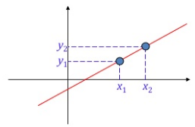
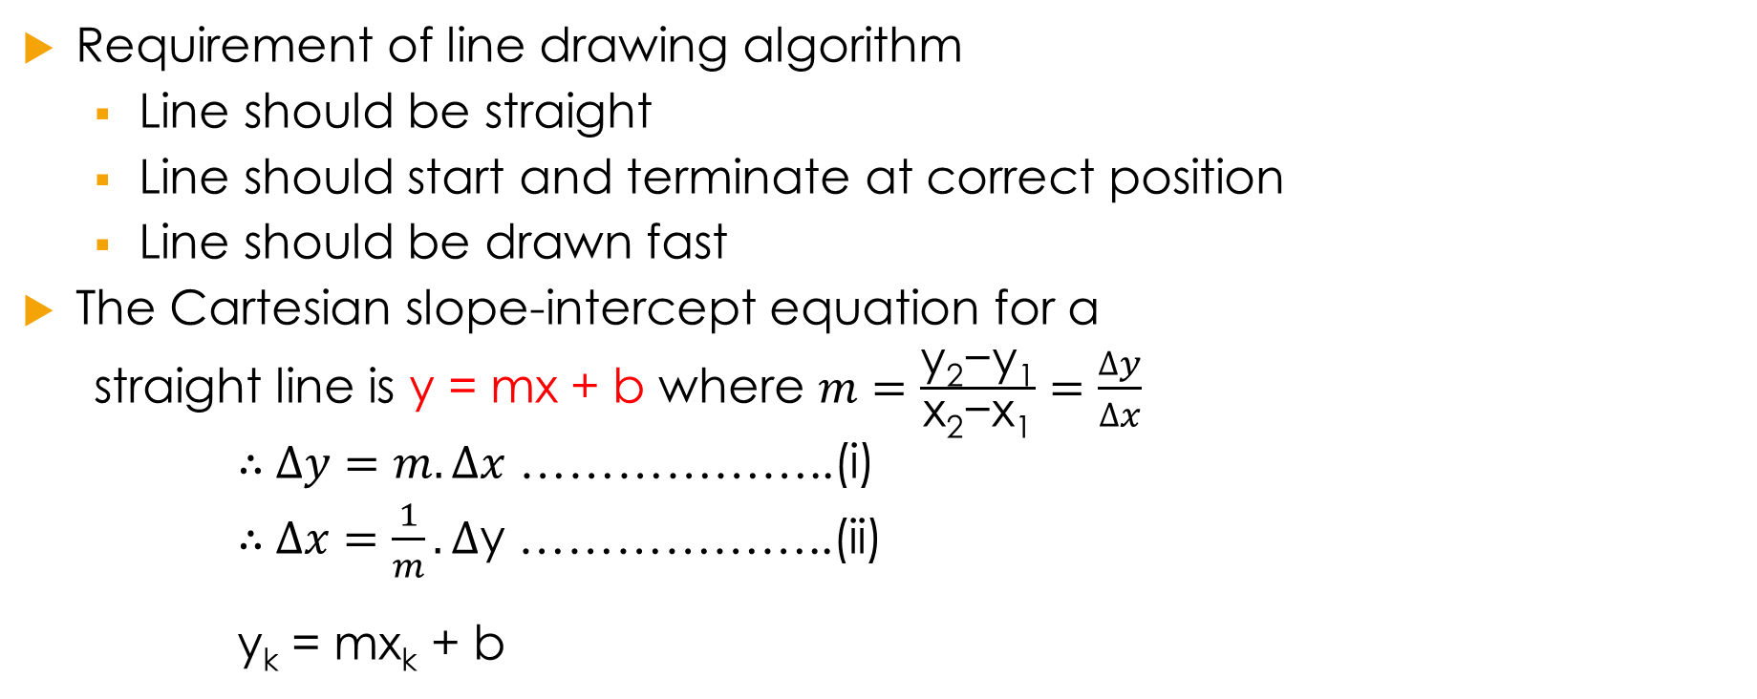
Line Drawing Algorithm
Requirement of line drawing algorithm
Line should be straight
Line should start and terminate at correct position
Line should be drawn fast
The Cartesian slope-intercept equation for a
straight line is y = mx + b where $m=\frac{\text{y}\text{2}\text{−}\text{y}\text{1}}{\text{x}\text{2}\text{−}\text{x}\text{1}}=\frac{∆y}{∆x}$
∴$∆y=m.∆x$ ………………..(i)
∴$∆x=\frac{1}{m}.∆$y ………………..(ii)
y_{k}= mx_{k}+ b

Slide 5
Remember!!!
x_{k} :the value of ‘x’ at any instant ‘k’
x_{k+1} :next value after x_{k}
x_{k}+1 :x_{k} is added with one pixel

Slide 6
Digital Differential Analyzer (DDA) Algorithm
DDA is a scan conversion line algorithm based on calculating either y interval (∆y) or x interval (∆x).
We sample the line at unit intervals in one coordinate and determine corresponding integer values nearest the line path for the other coordinate.
y_{k}=mx_{k}+b
If the slope(m) ≤ 1, we sample at unit ‘x’ interval (i.e. ∆x=1) and calculate each successive y as
y_{k+1} = mx_{k+1} + b = m(x_{k}+1) + b = mx_{k} + b + m
∴ y_{k+1} = y_{k} + m …………………….(iii)
where ‘k’ takes integer values starting from 1 and increases by 1 until the end point is reached.

Slide 7
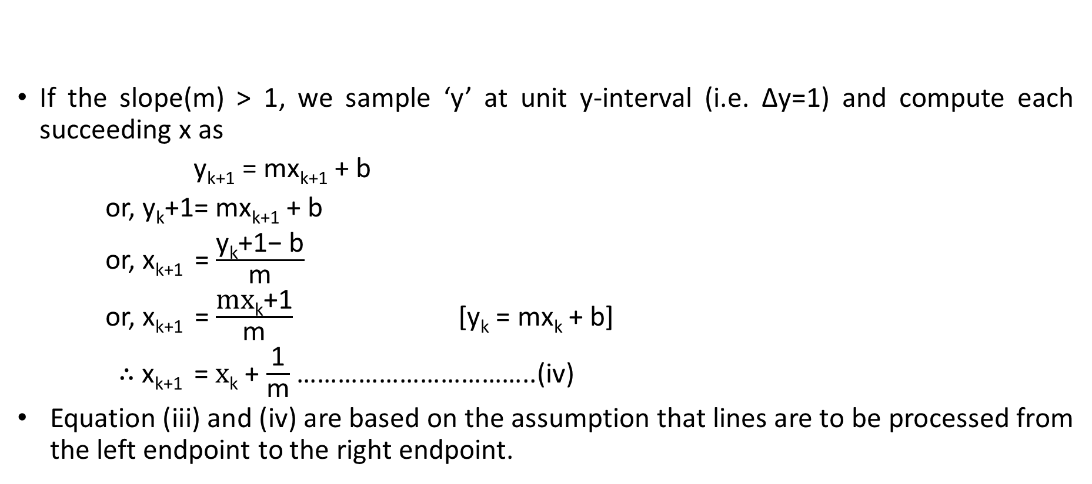
Contd…
If the slope(m) > 1, we sample ‘y’ at unit y-interval (i.e. ∆y=1) and compute each succeeding x as
y_{k+1} = mx_{k+1} + b
or, y_{k}+1= mx_{k+1}+ b
or, x_{k+1} =$\frac{\text{y}\text{k}\text{+1− }\text{b}}{\text{m}}$
or, x_{k+1} =$\frac{\text{mx}\text{k}\text{+1}}{\text{m}}$ [y_{k} = mx_{k} + b]
∴ x_{k+1} =$\text{x}\text{k}$ + $\frac{\text{1}}{\text{m}}$ ……………………………..(iv)
Equation (iii) and (iv) are based on the assumption that lines are to be processed from the left endpoint to the right endpoint.

Slide 8
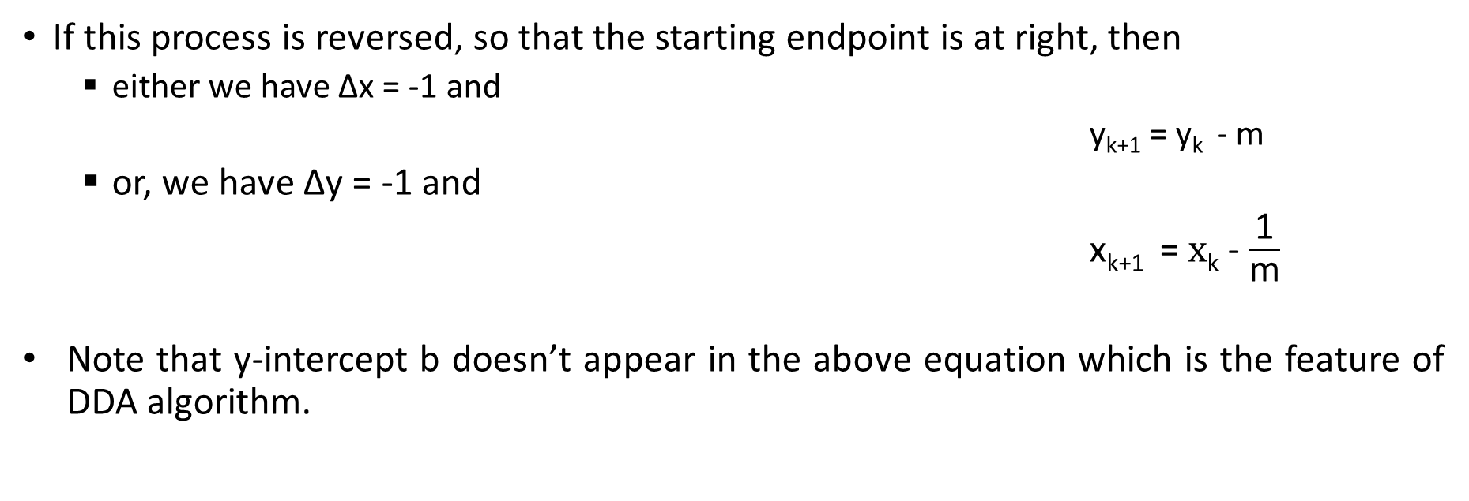
Contd…
If this process is reversed, so that the starting endpoint is at right, then
either we have ∆x = -1 and
y_{k+1}= y_{k} - m
or, we have ∆y = -1 and
x_{k+1} =$\text{x}\text{k}$- $\frac{\text{1}}{\text{m}}$
Note that y-intercept b doesn’t appear in the above equation which is the feature of DDA algorithm.

Slide 9
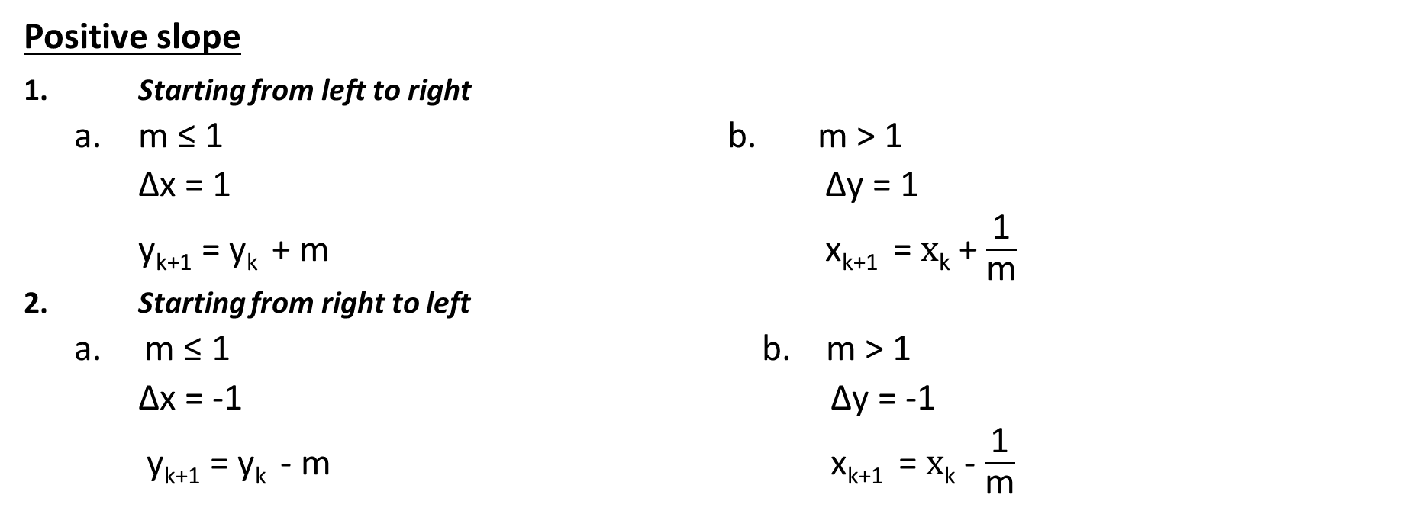
8 cases of DDA
Positive slope
1. Starting from left to right
a. m ≤ 1 b. m > 1
∆x = 1 ∆y = 1
y_{k+1}= y_{k} + m x_{k+1} =$\text{x}\text{k}$ + $\frac{\text{1}}{\text{m}}$
2. Starting from right to left
a. m ≤ 1 b. m > 1
∆x = -1 ∆y = -1
y_{k+1}= y_{k}- m x_{k+1} =$\text{x}\text{k}$- $\frac{\text{1}}{\text{m}}$

Slide 10
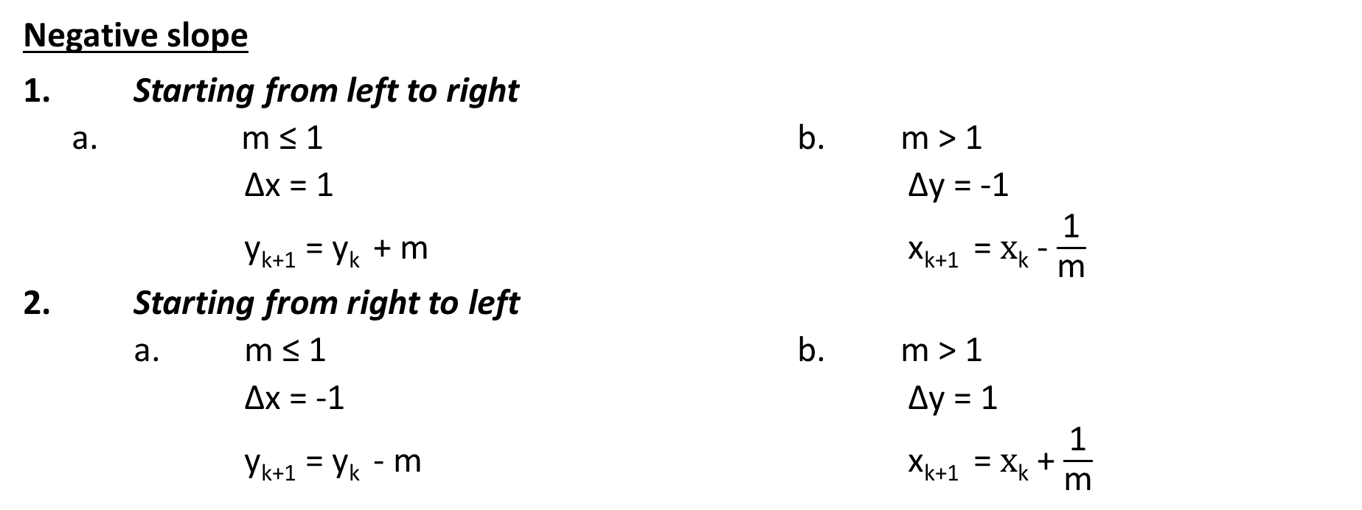
Contd…
Negative slope
1. Starting from left to right
a. m ≤ 1 b. m > 1
∆x = 1 ∆y = -1
y_{k+1} = y_{k} + m x_{k+1} =$\text{x}\text{k}$- $\frac{\text{1}}{\text{m}}$
2. Starting from right to left
a. m ≤ 1 b. m > 1
∆x = -1 ∆y = 1
y_{k+1} = y_{k} - m x_{k+1} =$\text{x}\text{k}$+ $\frac{\text{1}}{\text{m}}$

Slide 11
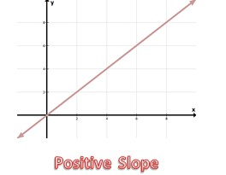
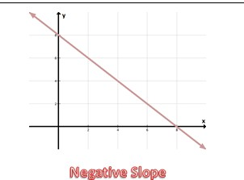
CASE 1
Positive Slope
(Y always increase when X increases and Y always Decreases when X decrease)
CASE 2
Negative Slope
(Y always increase when X decrease and Y always Decreases when X increases)

Slide 12
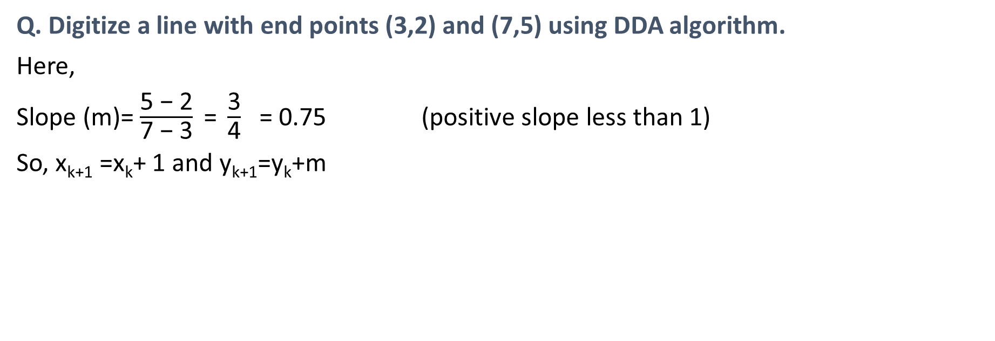
Numerical Examples
Q. Digitize a line with end points (3,2) and (7,5) using DDA algorithm.
Here,
Slope (m)= $\frac{\text{5 − 2}}{\text{7 − 3}} \text{=} \frac{\text{3}}{\text{4}}$ = 0.75 (positive slope less than 1)
So, x_{k+1} =x_{k}+ 1 and y_{k+1}=y_{k}+m
k |  |  | x_{k+1} = x_{k} +1 | y_{k+1} = y_{k} + m | (x_{k+1,} y_{k+1})
0 |  |  | 4 | 2.75 | (4,3)
1 |  |  | 5 | 3.5 | (5,4)
2 |  |  | 6 | 4.25 | (6,4)
3 |  |  | 7 | 5 | (7,5)

Slide 13
Algorithm (for positive slope & starting from left to right)
Read x₁, y₁, x₂, y₂ where (x₁, y₁) and (x₂, y₂) are two end points.
Calculate ∆x = x₂ - x₁ and ∆y = y₂ - y₁
If |∆x| ≥ |∆y| i.e. |m| ≤ 1
steps = ∆x
otherwise
steps = ∆y
end if
Calculate
x_{inc} = ∆x / steps and y_{inc} = ∆y / steps

Slide 14
Contd…
for i = 1 to steps in step of 1
plot(x₁, y₁)
//putpixel(x1,y1,RED)
x₁ = x₁ + x_{inc}
y₁ = y₁ + y_{inc}
end for
End

Slide 15
Advantages of DDA
It is the simplest algorithm and it doesn’t require special skills to implement.

Slide 16
Disadvantages of DDA
Rounding off operations and floating point operations in DDA algorithm consumes a lot of time.
Round off errors involved in successive addition of floating point increment can cause the calculated pixel position drift away from the path of the true line. With one coordinate always incremented in the unit steps, the resulting approximation may not close to true line.

Slide 17
Assignment
For all 8 cases, choose endpoints by yourself and digitize the lines using DDA algorithm. (Use graph paper for plotting)

Slide 18
Assignment
Digitize a line with end points (50,60) and (65,70) using DDA algorithm.
Digitize the line from A(1,1) to B(10,8) using scan conversion line algorithm.
Draw a line with two endpoints P(5,3) and Q(1,2) using DDA algorithm.
Digitize the line with endpoints A(1,7) and B(6,3) using digital differential analyzer line drawing algorithm. Show all necessary steps.
Digitize the line with endpoints (1,2) and (5,6) using digital differential analyzer method.
Draw a line using DDA with two endpoints A(0,0) and B(-10,8).
Digitize a line using DDA with all necessary steps with two endpoints (7,10) and (2,19).

Slide 19
Bresenham’s Line Drawing Algorithm
The BLA is a more efficient method used to plot pixel position along a straight-line path.
Advantage of BLA over DDA
In DDA algorithm each successive point is computed in floating point, so it requires more time and more memory space. While in BLA each successive point is calculated in integer value or whole number. So it requires less time and less memory space.
In DDA, since the calculated point value is floating point number, it should be rounded at the end of calculation but in BLA it does not need to round, so there is no accumulation of round off error.
Due to round off error, the line drawn by DDA algorithm is not accurate, while in BLA line is accurate.
BLA can be extended in other application such as for drawing circle, ellipse and other curves.

Slide 20
Derivation: For positive slope less than 1(|m|<1)
Let us assume that pixel (x_{k}, y_{k}) is already plotted assuming that the sampling direction is along X-axis i.e. (x_{k}+1, y_{k}) or (x_{k}+1, y_{k}+1). Thus, the common equation of the line is y_{k}=mx_{k}+c.
We draw a scan line y whose pixel separation from the line path is ‘d₁’ and ‘d2’.
Now,
y = m(x_{k}+1) + c
d₁ = y - y_{k} = m (x_{k} +1) + c - y_{k}
d₂ = (y_{k} +1)- y = y_{k}+1– {m (x_{k} +1) + c }

Slide 21
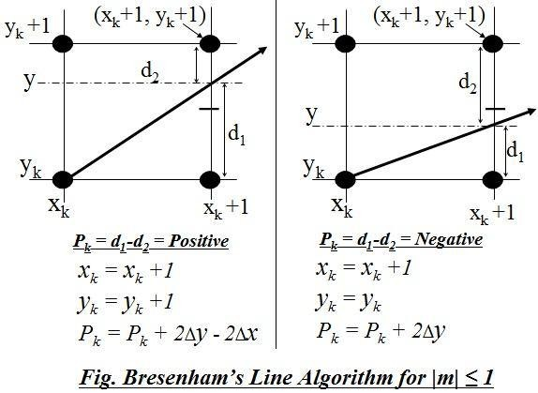
y = m(x_{k}+1) + c
Now,
d₁ = y - y_{k} = m (x_{k} +1) + c - y_{k} and
d₂ = (y_{k} +1)- y = y_{k}+1– {m (x_{k} +1) + c }

Slide 22
The difference bet^{n} these two separation is,
d₁ - d₂ = [m (x_{k} +1) + c - y_{k} ] - [y_{k}+1– {m (x_{k} +1) + c }]
d₁- d₂ = 2m (x_{k}+1)+ 2c - 2y_{k} -1
Since, slope of line (m) = Δy / Δx,
We have,
Δx (d₁- d₂) = 2 Δy (x_{k}+1)+ 2 Δx c - 2 Δx y_{k} – Δx
Define Decision parameter at k^{th} step,
p_{k} = Δx (d₁- d₂)
= 2 Δy (x_{k}+1)+ 2 Δx c - 2 Δx y_{k} – Δx
=2 Δy x_{k}+2 Δy + 2 Δx c - 2 Δx y_{k} – Δx

Slide 23
Thus,
p_{k}=2 Δy x_{k}+2 Δy + 2 Δx c - 2 Δx y_{k} – Δx
Now ,the successive decision parameter is obtained as
p_{k+1} = 2 Δy x_{k+1}+2 Δy + 2 Δx c - 2 Δx y_{k+1} – Δx
Here,
p_{k+1}- p_{k} = 2 Δy x_{k+1}+2 Δy + 2 Δx c - 2 Δx y_{k+1} – Δx – {2 Δy x_{k}+2
Δy + 2 Δx c - 2 Δx y_{k} – Δx }
= 2 Δy x_{k+1}+2 Δy + 2 Δx c - 2 Δx y_{k+1} – Δx – 2 Δy x_{k}
- 2Δy - 2 Δx c + 2 Δx y_{k} +Δx
p_{k+1} = p_{k} +2 Δy x_{k+1} - 2 Δx y_{k+1}– 2 Δy X_{k}+ 2 Δx y_{k}

Slide 24
p_{k+1} = p_{k} +2 Δy(x_{k+1} – x_{k})- 2 Δx(y_{k+1}– y_{k})
Case 1
If P_{k} < 0 (i.e. d₁-d₂ is Negative )
then,
x_{k+1} = x_{k}+1
^{y}k+1 ^{= y}k
p_{k+1} = p_{k} + 2 Δy
Case 2
If P_{k} ≥ 0 (i.e. d₁-d₂ is Positive ) then,
x_{k+1} = x_{k}+1
y_{k+1} = y_{k}+1
p_{k+1} = p_{k} + 2 Δy -2Δx

Slide 25
p_{k} =2 Δy X_{k}+2 Δy + 2 Δx c - 2 Δx y_{k} – Δx
Initial Decision Parameter (P₀) at (x0,y0)
p₀ =2 Δy x₀+2 Δy + 2 Δx c - 2 Δx y₀ – Δx
=2 Δy x₀+2 Δy + 2 Δx{y₀-(Δy/ Δx)x₀ } - 2 Δx y₀ – Δx
=2 Δy x₀+2 Δy + 2 Δxy₀-2Δyx₀ - 2 Δx y₀ – Δx
y_{k} = mx_{k} + c
At(x_{k},y_{k})=(x₀,y₀),
y₀=mx₀+c
c=y₀-mx₀
c=y₀-(Δy/ Δx)x₀
p₀ = 2 Δy - Δx

Slide 26
For slope |m|<1
Initial Decision Parameter:
p₀ = 2 Δy - Δx
p₀ = 2 Δy - Δx
Case 1
If p_{k} < 0 then,
x_{k+1} = x_{k}+1
^{y}k+1 ^{= y}k
P_{k+1} = P_{k} + 2 Δy
Case 2
If p_{k} ≥ 0 then,
x_{k+1} = x_{k}+1
y_{k+1} = y_{k}+1
p_{k+1} = p_{k} + 2 Δy -2Δx

Slide 27
Example-1: Digitize the line with end points (20, 10) and (30, 18) using Bresenham Algorithm
Solution :
Here, Starting point of line = (x₁, y₁) = (20, 10) and
Ending point of line = (x₂, y₂) = (30, 18)
Thus, slope of line, m = Δy / Δx = (y2-y1) / (x2-x1)
= (18-10) / (30-20)
= 8/10=0.8
As the given points, it is clear that the line is moving left to right with the positive slope
|m| = 0.8 <1

Slide 28
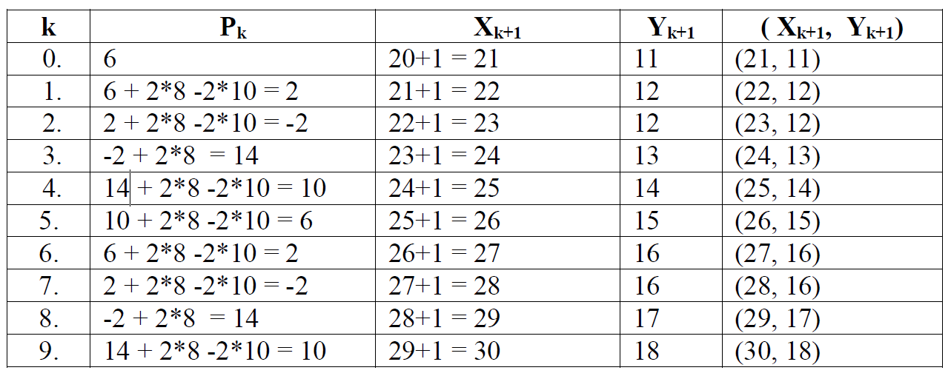
Case 1
Case 2
If p_{k} < 0 then,
x_{k+1} = x_{k}+1
^{y}k+1 ^{= y}k
p_{k} = p_{k} + 2 Δy
If p_{k} ≥ 0
then,
x_{k+1} = x_{k}+1
y_{k+1} = y_{k}+1
p_{k} = p_{k} + 2 Δy -2Δx
The initial decision parameter (P₀) = 2Δy - Δx = 2*8 – 10 = 6.Starting point is (20,10)
Since, for the Bresenham’s Line drawing Algorithm of slope, |m| ≤ 1, we have

Slide 29
Example-2: Digitize the line with end points (15, 5) and (30, 10)
using BLA.
Example-3: Digitize the line with end points (20, 5) and (25, 10)
using BLA.

Slide 30
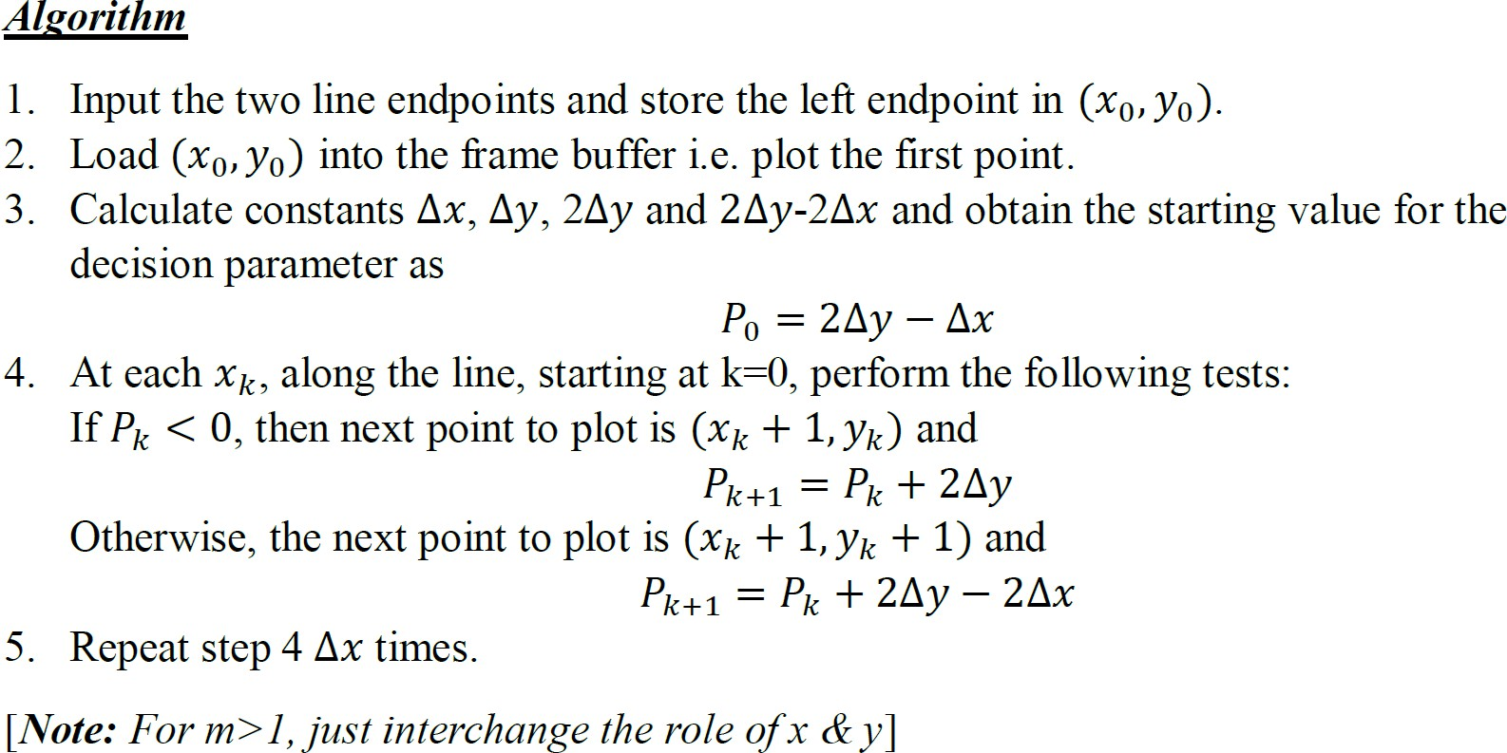

Slide 31
Bresenham’s line algorithm for |m|<1
Step 1:Input two end points of the line (x₁,y₁) and (x₂,y₂).
Step 2:Plot the first point (x₁,y₁).
//putpixel(x1,y1,RED);
Step 3:Calculate
delx=|x₂-x₁|
dely=|y₂-y₁|
Calculate initial decision parameter p=2*dely-delx

Slide 32
Step 4: for i=0 to delx in step of 1
If p<0 then
x₁=x₁+1
Plot(x₁,y₁)
p=p+2*dely
else
x₁=x₁+1
y₁=y₁+1
Plot(x₁,y₁)
p=p+2*dely-2*delx
end for
Step 5: End

Slide 33
Derivation: For positive slope greater than 1(|m|>1)
Here, we sample y at unit interval and x is sampled depending upon the decision parameter. Assuming that pixel (x_{k}, y_{k}) is plotted the next pixel to be plotted is either (x_{k}, y_{k}+1) or (x_{k}+1, y_{k}+1).
Thus, the common equation of the line is y_{k}=mx_{k}+c.
We draw a scan line x whose pixel separation from the line path is ‘d₁’ and ‘d2’.
Equation of a straight line is y=mx+c
y_{K}+1 = mx + c
x= {y_{k}+1 – c}/m
Now,
d₁ = x - x_{k} = {y_{k} +1 – c}/m - x_{k} and
d₂ = (x_{k} +1)- x = x_{k}+1– {y_{k}+1 – c}/m

Slide 34
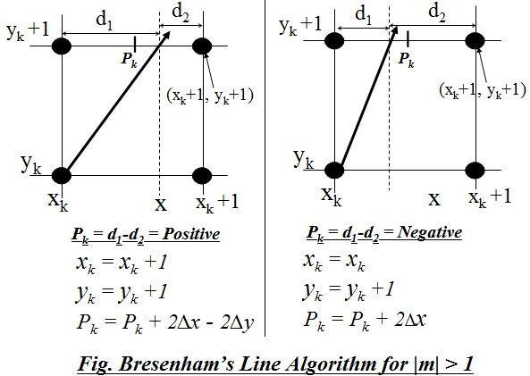
(x_{k},
)
d
(x_{k},
)
Now,
d₁ = x - x_{k} = {y_{k} +1 – c}/m - x_{k} and
d₂ = (x_{k} +1)- x = x_{k}+1– {y_{k}+1 – c}/m
(
,Y_{k})

Slide 35
The decision parameter is obtained as
d₁ - d₂ = [{y_{k} +1 – c}/m - x_{k}] -[x_{k}+1–{{y_{k}+1 – c}/m }]
d₁ - d₂ = 2/m* (y_{k}+1) - 2c/m – 2x_{k} -1
Since, slope of line (m) = Δy / Δx, we have
p_{k} = Δy (d₁ - d₂)= 2Δx (y_{k}+1) - 2c Δx - 2Δy x_{k}- Δy

Slide 36
p_{k} = 2Δx (y_{k}+1) - 2c Δx - 2Δy x_{k} - Δy
Now ,the successive decision parameter is
p_{k+1} = 2Δx (y_{k+1}+1) - 2c Δx - 2Δy x_{k+1} – Δy
Here,
p_{k+1}-p_{k} = {2Δx (y_{k+1}+1) - 2c Δx - 2Δy x_{k+1} – Δy} -{2Δx (y_{k}+1) - 2c Δx - 2Δy x_{k} - Δy}
= 2Δx (y_{k+1} - y_{k}) - 2Δy (x_{k+1} - x_{k})
p_{k+1} = p_{k} + 2Δx (y_{k+1} - y_{k}) - 2Δy (x_{k+1} - x_{k})

Slide 37
p_{k+1} = p_{k} + 2Δx (y_{k+1} - y_{k}) - 2Δy (x_{k+1} - x_{k})
Case 1
If p_{k} < 0 then,
^{X}_{k+1} ^{= X}_{k}
y_{k+1} = y_{k}+1
p_{k+1} = p_{k} + 2 Δx
Case 2
If p_{k} ≥ 0 then,
x_{k+1} = x_{k}+1
y_{k+1} = y_{k}+1
p_{k+1} = p_{k} + 2 Δx -2Δy

Slide 38
p_{k} = 2Δx (y_{k}+1) - 2c Δx - 2Δy x_{k} - Δy
Initial Decision Parameter (P₀) at (x0,y0)
p₀ =2 Δx y₀+2 Δx - 2 Δx c - 2 Δy x₀ – Δy
=2 Δxy₀+2 Δx -2 Δx{y₀-(Δy/ Δx)x₀ } - 2 Δy x₀ – Δy
=2 Δx y₀+2 Δx -2 Δxy₀+2Δyx₀ - 2 Δy x₀ – Δy
y_{k} = mx_{k} + c
At(x_{k},y_{k})=(x₀,y₀),
y₀=mx₀+c
c=y₀-mx₀
c=y₀-(Δy/ Δx)x₀
p₀ = 2 Δx - Δy

Slide 39
For slope |m|>1
Initial Decision Parameter:
p₀ = 2 Δy - Δx
Case 1
If p_{k} < 0 then,
^{X}_{k+1} ^{= X}_{k} y_{k+1} = y_{k}+1
p_{k+1} = p_{k} + 2 Δx
Case 2
If p_{k} ≥ 0 then,
x_{k+1} = x_{k}+1
y_{k+1} = y_{k}+1
p_{k+1} = p_{k} + 2 Δx -2Δy
p₀ = 2 Δx - Δy

Slide 40
Example: Digitize the line with end points (1, 0) and (3, 3) using BLA.
Solution
Here,
Starting point of line = (x₁, y₁) = (1, 0) and
Ending point of line = (x₂, y₂) = (3, 3)
Thus,
slope of line, m = Δy / Δx = (y2-y1) / (x2-x1)
= (3-0) / (3-1)
= 3/2
As the given points, it is clear that the line is moving left to right with the positive slope,
|m| = 1.5 >1

Slide 41
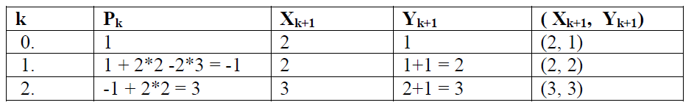
Thus, the initial decision parameter(p₀)
= 2Δx - Δy = 2*2 – 3 = 1
we have
Δx = x₂-x₁ = 3-1 = 2
Δy = y₂-y₁ = 3-0 = 3
If P_{k} < 0 then,
^{x}k+1 ^{= x}k
y_{k+1} = y_{k}+1
P_{k+1} = p_{k} + 2 Δx
If P_{k} ≥ 0
then,
x_{k+1} = x_{k}+1
y_{k+1} = y_{k}+1
p_{k+1} = p_{k} + 2 Δx -2Δy
(x₁,y₁)=(1,0)

Slide 42
Practice Questions
Digitize A(5,2) and B(7,8) using BLA.
Digitize the line A(1,1) and B(5,6) using BLA.
Digitize the line A(7,8) and B(1,4) using BLA.
Digitize the line A(1,1) and B(5,6) using DDA.
Digitize the line A(5,2) and B(7,8) using BLA.
Digitize the line A(0,0) and B(10,10) using BLA.
Digitize the line A(1,3) and B(10,10) using BLA and DDA.

Slide 43
Example: Digitize the line with end points (10, 7) and (5, 10) using BLA.

Slide 44
Example: Digitize the line with end points (10, 7) and (5, 10) using BLA.
Here,
(x₁,y₁)= (10,7)
(x₂,y₂)=(5,10)
Δx = |5-10| = 5
Δy = |10-7| = 3
Slope(m)= (10-7)/(5-10) = -3/5 –ve slope less than 1 i.e |m| < 1

Slide 45
Case 1
Case 2
If p_{k} < 0 then,
x_{k+1} = x_{k}-1
^{y}_{k}+1 ^{= y}k
p_{k} = p_{k} + 2 Δy
If p_{k} ≥ 0
then,
x_{k+1} = x_{k}-1
y_{k+1} = y_{k}+1
p_{k} = p_{k} + 2 Δy -2Δx
The initial decision parameter (P₀) = 2Δy - Δx = 2*3 – 5 = 1.Starting point is (10,7)
Since, for the Bresenham’s Line drawing Algorithm of slope, |m| ≤ 1, we have
K | P_{k} | ^{X}k+1 | ^{Y}k+1 | ^{(X}k+1^{, Y}k+1⁾
0 | 1 | 9 | 8 | (9,8)
1 | = 1 + 2x3 - 2x5 =-3 | 8 | 8 | (8,8)
2 | = -3 + 2x3 = 3 | 7 | 9 | (7,9)
3 | = 3 + 2x3 – 2x5 = -1 | 6 | 9 | (6,9)
4 | = -1 + 2x3 = 5 | 5 | 10 | (5,10)

Slide 46
Example: Digitize the line with end points (6,2) and (3, 10) using BLA.

Slide 47
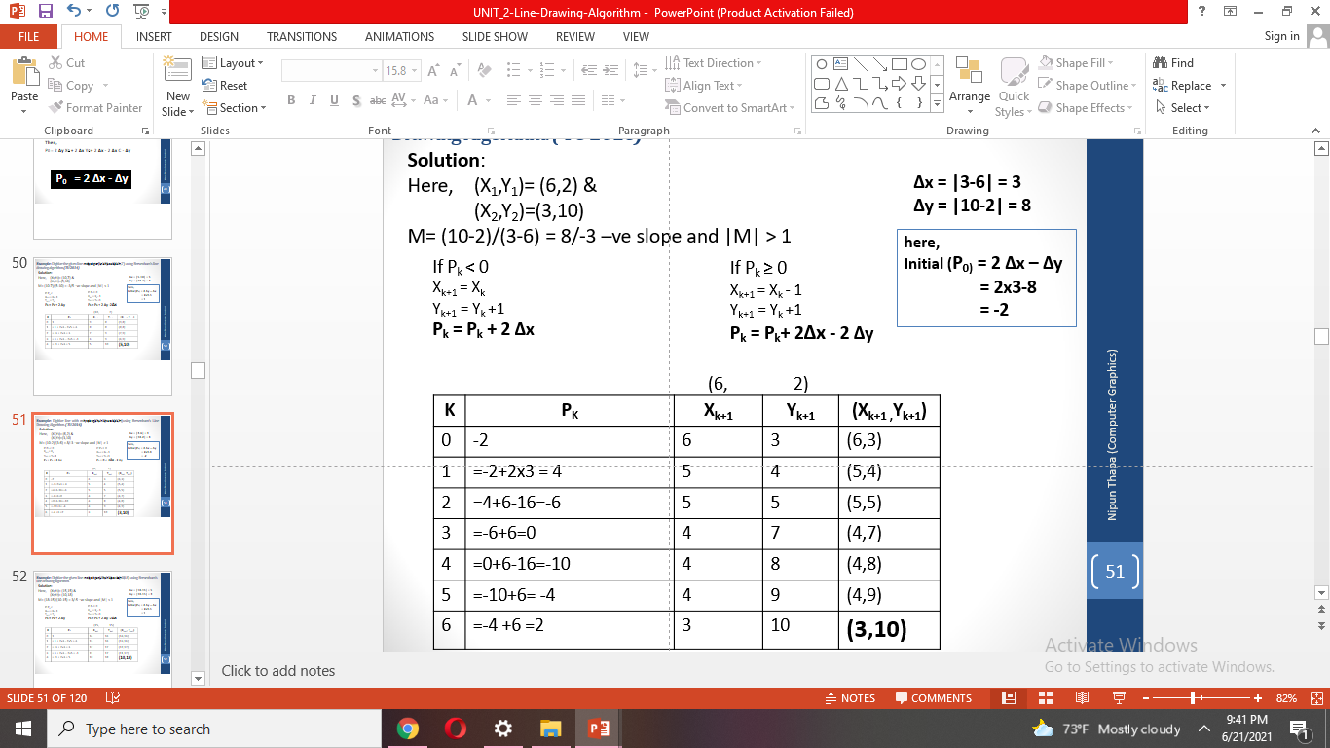
Example: Digitize the line with end points (6,2) and (3, 10) using BLA.

Slide 48
Practice Questions
Example: Digitize the line with end points (15,15) and (10,18) using BLA.
Example: Digitize the line with end points (20,5) and (10,10) using BLA.

Slide 49
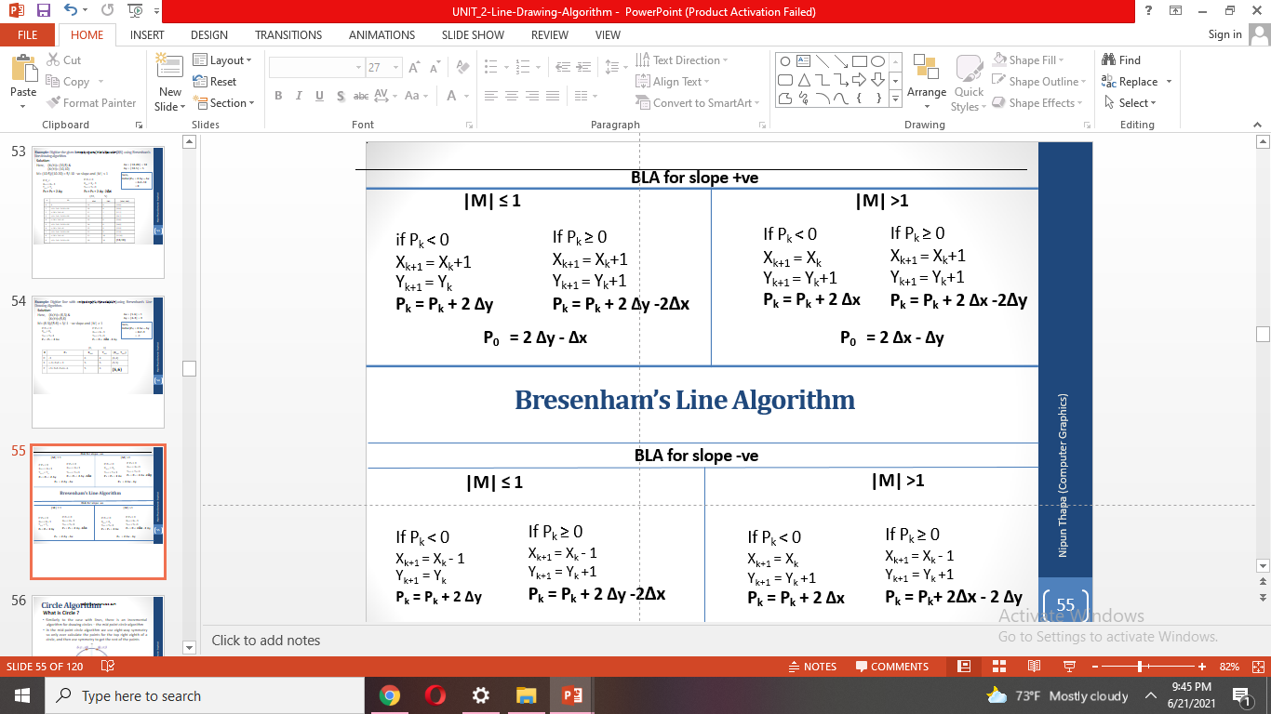
Summary

Slide 50
Advantages of Bresenham’s line algorithm (BLA) over DDA:
In DDA algorithm each successive point is computed in floating point, so it required more time and memory space. While in BLA each successive point is calculated in integer value or whole number. So it requires less time and less memory
In DDA, since the calculated point value is floating point number, it should be rounded at the end of calculation but in BLA it does not need to round, so there is no accumulation of rounding error.
Due to rounding error, the line drawn by DDA algorithm is not accurate, while in BLA line is accurate.
DDA algorithm cannot be used in other application except line drawing but BLA can be implemented in other application such as circle, ellipse and other curves.

Slide 51
Differentiate between DDA Algorithm and Bresenham's Line Algorithm:
DDA Algorithm | Bresenham's Line Algorithm
1. DDA Algorithm use floating point, i.e. Real Arithmetic. | 1. Bresenham's Line Algorithm use fixed point, i.e. Integer Arithmetic
2. DDA Algorithms uses multiplication & division on its operation | 2.Bresenham's Line Algorithm uses subtraction and addition on its operation
3. DDA Algorithm is slower than Bresenham's Line Algorithm in line drawing because it uses real arithmetic (Floating Point operation) | 3. Bresenham's Algorithm is faster than DDA Algorithm in line because it involves addition & subtraction in its calculation and uses only integer arithmetic.
4. DDA Algorithm is not accurate and efficient as Bresenham's Line Algorithm. | 4. Bresenham's Line Algorithm is more accurate and efficient than DDA Algorithm.
5.DDA Algorithm can draw circle and curves but are not accurate as Bresenham's Line Algorithm | 5. Bresenham's Line Algorithm can draw circle and curves with more accurate than DDA Algorithm.

Slide 52
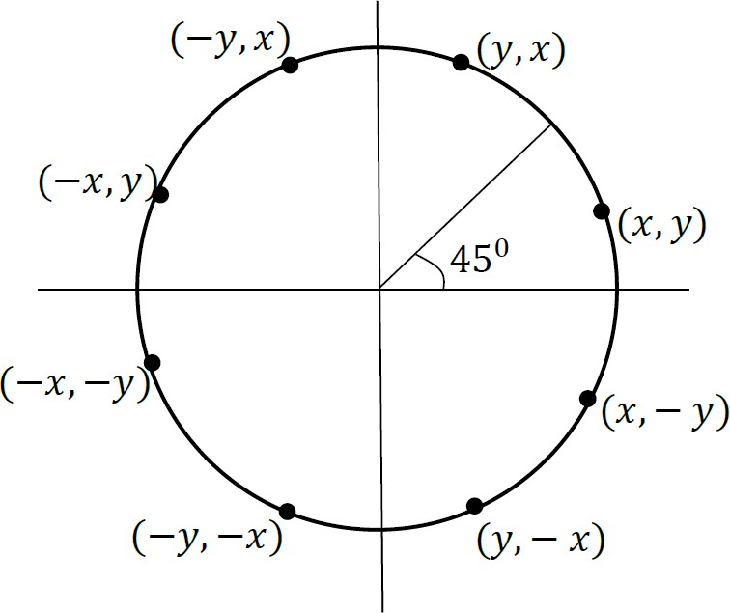
Circle
Circle is defined as a set of points that are all at a given distance ‘r’ from the center position (𝑥_{𝑐}, 𝑦_{𝑐}).
Equation of circle centered at (𝑥_{𝑐}, 𝑦_{𝑐}) with radius ‘r’ is
(𝑥 − 𝑥_{𝑐})² + (𝑦 − 𝑦_{𝑐})² = 𝑟²
Symmetry of Circle
Calculation of circle point ( 𝑥 , 𝑦 ) in one octant yields the circle points shown for the other seven octants.

Slide 53
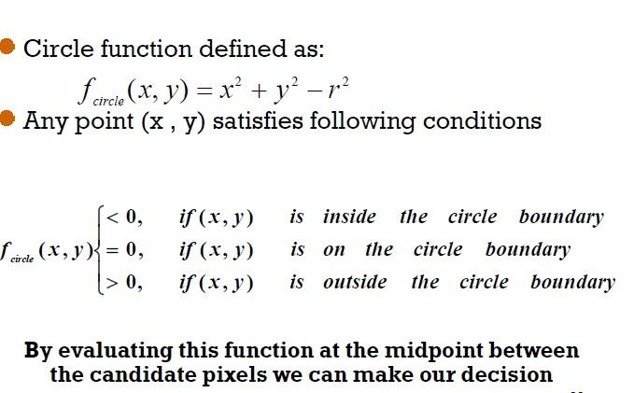
Mid Point Circle Algorithm
To apply the mid point circle algorithm, we define a circle function as

Slide 54
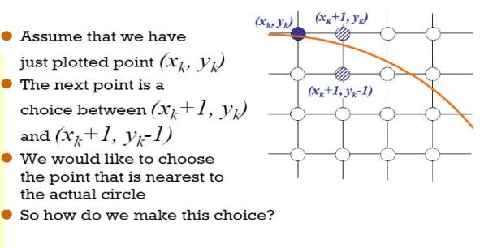
For this, the sign of f_{circle}(x, y) is tested for the midpoint (x_{k+1},y_{k-1/2}) i.e between two probable pixels.

Slide 55
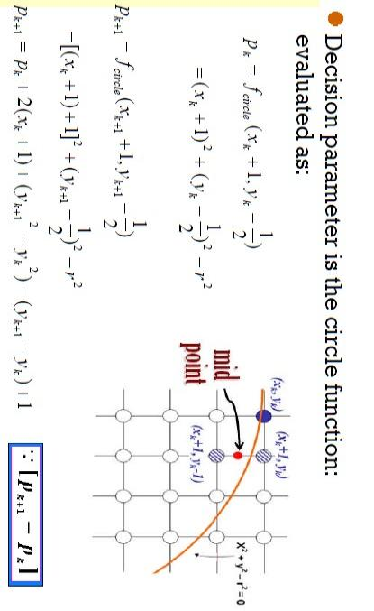
Successive decision parameter is

Slide 56
Case 1 : P_{k} < 0
x_{k+1} = x_{k} +1
^{y}k+1 ^{= y}k
p_{k+1} = P_{k} + 2(x_{k}+1) + 1
p_{k+1} = p_{k} + 2x_{k+1} + 1
k
Case 2: pk ≥ 0 x_{k+1} = x_{k} +1 y_{k+1} = y_{k} - 1
^{p}k+1
= p_{k} + 2(x_{k}+1) + [(y_{k} – 1)² - y ²)] - (y_{k} - 1 - y_{k}) +1
k
= p_{k}+2(x_{k}+1) + [(y_{k} ² - 2y_{k} +1 – y_{k} ²)] - (y_{k}-1- y_{k}) + 1
= p_{k}+2(x_{k}+1) - 2y_{k} +1 +1 + 1
= p_{k}+2(x_{k}+1) – 2(y_{k} +1) +1
= p_{k}+2x_{k+1} – 2y_{k+1} +1
p₀ ≈ 1-r
^{p}k+1

Slide 57
An initial decision parameter is calculated at (x₀,y₀)=(0,r)
Here ,
p_{k}=f_{circle}(x_{k+1},y_{k-1/2})=f_{circle}(x_{k}+1-y_{k}-1/2)
At k=0,
p₀=f_{circle} (1,r-𝟏/𝟐)
Now,
p₀ = 1²+(r-1/2 )² – r²
= 1 + r²- r + ¼ - r²
= ⁵/₄ – r
p₀ ≈ 1-r

Slide 58
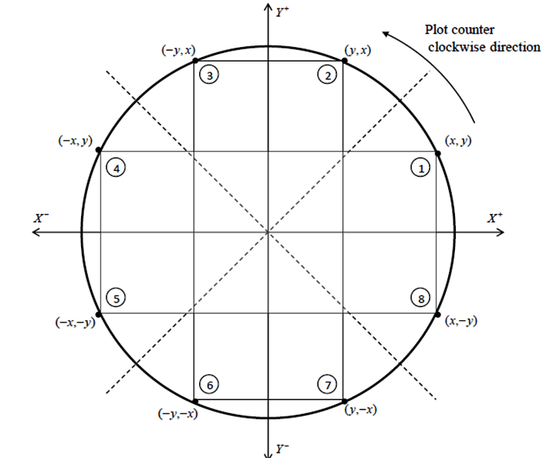
We use the mid-point algorithm to calculate all the perimeter points of the circle in the first octant and then print them along with their mirror points in the other octants. This will work because a circle is symmetric about it’s center.

Slide 59
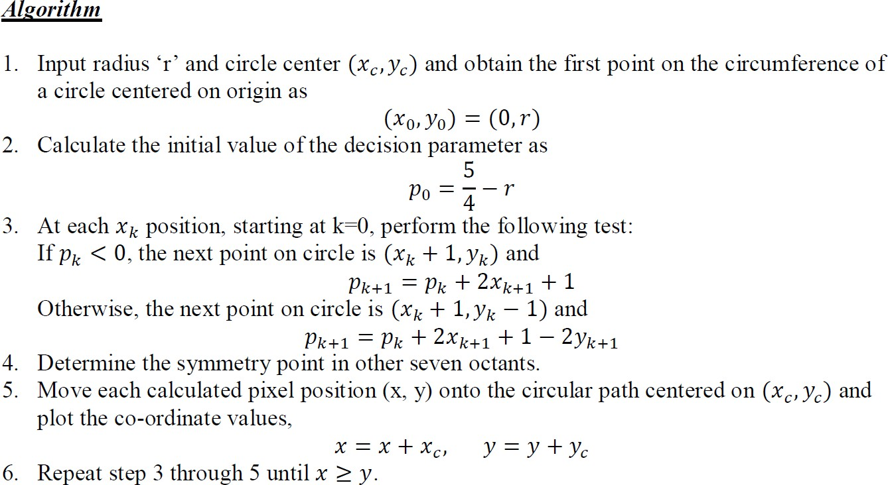

Slide 60
Mid Point Circle Algorithm
Input radius(r) and circle center (xc,yc).
Obtain the first point on the circumference of a circle centered on the origin as
(x,y)=(0,r)
3. Calculate the initial decision parameter as
p=5/4-r ≈ 1-r
4. While x<=y
Perform the following test
If p<0 then
x=x+1
p =p+2x+1
Else
x=x+1
y=y-1
p=p+2x-2y+1
End if
Plot the symmetry points on the other quadrant as
(xc+x,yc+y) (xc+y,yc+x) (xc-x,yc+y) (xc-y,yc+x)
(xc+x,yc-y) (xc+y,yc-x) (xc-x,yc-y) (xc-y,yc-x)
end while
5. End

Slide 61
Digitize a circle with radius 10 units and center at origin.
Solution
For the Midpoint Circle Algorithm of initial point at (0, r) and
center at origin (0, 0) rotating at clockwise direction, we have
Initial point (x₀,y₀) = (0,10)
Here, the initial decision parameter
(p₀) =1 – r = 1-10 = - 9

Slide 62
Case 1 : pk < 0
x_{k+1} = x_{k} +1
^{y}k+1 ^{= y}k
Case 2: Pk ≥ 0 x_{k+1} = x_{k} +1 y_{k+1} = y_{k} - 1
p_{k+1} = p_{k} + 2x_{k+1} + 1
^{p}k+1
= p_{k}+2x_{k+1} – 2y_{k+1} +1
Thus,
Starting pixel=(0,r) =
(0 , 10)
k | p_{K} | ^{X} _{k+1} | ^{y} _{k+1} | ^{( x} _{k+1}^{, y} _{k+1}⁾
0 | -9 | 0+1 = 1 | 10 | (1,10)
1 | = -9 + 2*1 +1= -6 | 1+1=2 | 10 | (2, 10)
2 | =-6 + 2*2 +1= -1 | 2+1=3 | 10 | (3, 10)
3 | =-1 + 2*3 +1= 6 | 3+1 = 4 | 10-1=9 | (4, 9)
4 | =6 + 2*4 - 2*9 +1= -3 | 4+1 = 5 | 9 | (5, 9)
5 | =-3 + 2*5 +1= 8 | 5+1 = 6 | 9-1=8 | (6, 8)
6 | =8 + 2*6 - 2*8 +1= 5 | 6+1 = 7 | 8-1=7 | (7, 7)
While(x<=y)

Slide 63
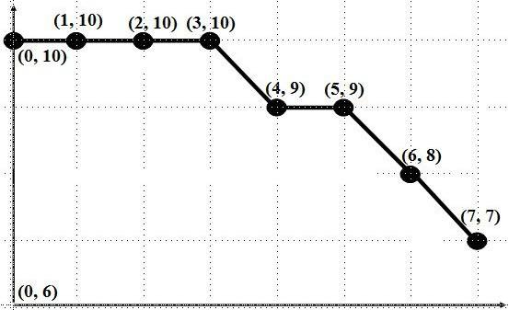
So the intermediate pixels are (1,10),(2,10),(3,10),(4,9),(5,9),(6,8),(7,7)

Slide 64
Digitize a circle with radius 9 units and the center at (6,7)

Slide 65
Digitize a circle with radius 9 units and the center at (6,7)
Here, the initial decision parameter (p0)
p₀ =1 – r = 1-9 = - 8
Since, for the Midpoint Circle Algorithm of starting point (0, r) &
centre at origin (0, 0) rotating at clockwise direction, we have
If p_{k} < 0
Next pixel is (x_{k} +1, y_{k} )
p_{k+1} = p_{k} + 2x_{k+1} + 1
Else
Next pixel is (x_{k} +1, y_{k} - 1)
p_{k+1} = p_{k}+2x_{k+1} – 2y_{k+1} +1

Slide 66
k | p_{k} | xk+1 | yk+1 | (xk+1, yk+1) At (0, 0) | (xk+1, yk+1) At (6, 7)
0. | -8 | 0+1 = 1 | 9 | (1, 9) | (1+6, 9+7) = (7, 16)
1. | = -8 + 2*1 +1= -5 | 1+1 = 2 | 9 | (2, 9) | (2+6, 9+7) = (8, 16)
2. | = -5 + 2*2 +1= 0 | 2+1 = 3 | 8 | (3, 8) | (3+6, 8+7) = (9, 15)
3. | = 0 + 2*3 - 2*8 +1=-9 | 3+1 = 4 | 8 | (4, 8) | (4+6, 8+7) = (10,15)
4. | = -9 + 2*4 +1= 0 | 4+1 = 5 | 7 | (5, 7) | (5+6, 8+7) = (11,15)
5. | = 0 + 2*5 - 2*7 +1=-3 | 5+1 = 6 | 7 | (6, 7) | (6+6, 7+7) = (12,14)
6. | = -3 + 2*6 +1= 10 | 6+1 = 7 | 6 | (7, 6) | (7+6, 6+7) = (13,13)

Slide 67
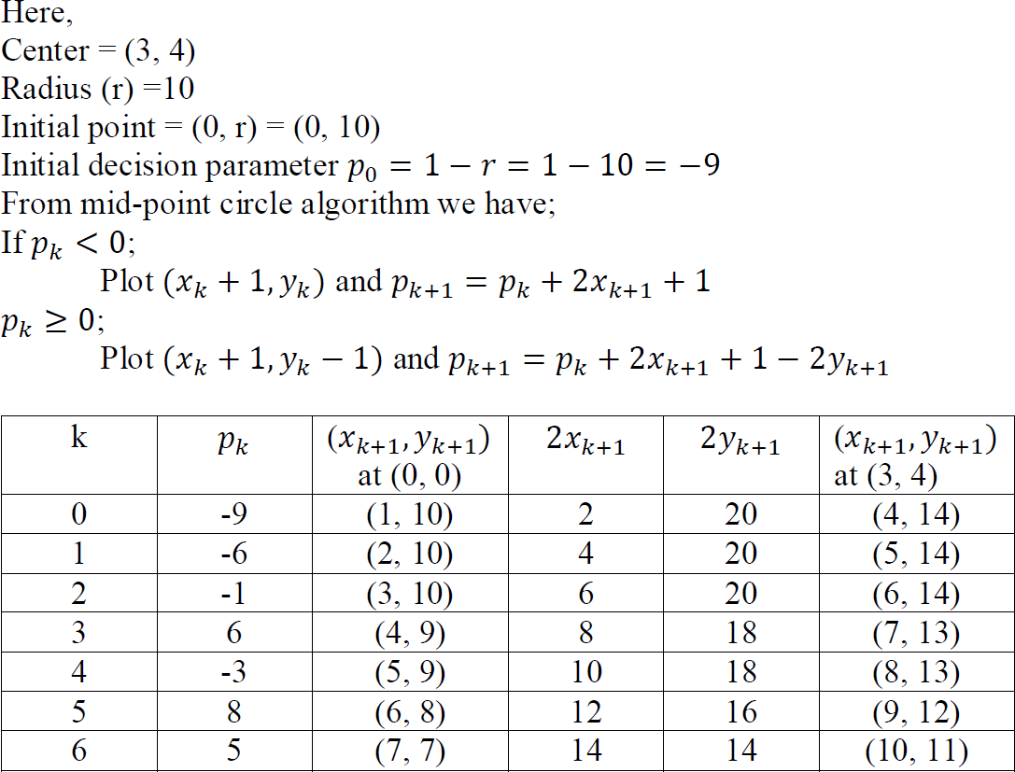
Q. Digitize the circle with radius r =10 centered (3, 4) in first octant.
Solution:
Note: When center is not origin, we first calculate the octants points of the circle in the same way as the center at origin then add the given circle center on each calculated pixel.

Slide 68
Q. Digitize the circle with radius r =5 centered (2, 3).
Solution:
Here,
Center = (2, 3)
Radius (r) =5
Initial point = (0, r) = (0, 5)
Initial decision parameter 𝑝₀ = 1 − 𝑟 = 1 − 5 = −4
From mid-point circle algorithm we have;
If 𝑝_{𝑘} < 0;
Plot (𝑥_{𝑘} + 1,𝑦_{𝑘}) and 𝑝_{𝑘+1} = 𝑝_{𝑘} + 2𝑥_{𝑘+1} + 1
𝑝_{𝑘} ≥ 0;
Plot (𝑥_{𝑘} + 1,𝑦_{𝑘} − 1) and 𝑝_{𝑘+1} = 𝑝_{𝑘} + 2𝑥_{𝑘+1} + 1 − 2𝑦_{𝑘+1}

Slide 69
 |  | st 1 |  |  | Other pixels (in …octant)
K | 𝑝_{𝑘} | ^{(𝑥}𝑘+1^{,𝑦}𝑘+1⁾ | ^{2𝑥}𝑘+1 | ^{2𝑦}𝑘+1 | nd 2 | rd 3 | th 4 | th 5 | th 6 | th 7 | th 8
0 | -4 | (1, 5) | 2 | 10 | (5,1) | (-5,1) | (-1, 5) | (-1, -5) | (-5,-1) | (5,- 1) | (1, -5)
1 | -1 | (2, 5) | 4 | 10 | (5,2) | (-5,2) | (-2, 5) | (-2, -5) | (-5,-2) | (5, -2) | (2, -5)
2 | 4 | (3, 4) | 6 | 8 | (4,3) | (-4,3) | (-3, 4) | (-3, -4) | (-4,-3) | (4, -3) | (3, -4)
3 | 3 | (4, 3) | 8 | 6 | (3,4) | (-3,4) | (-4, 3) | (-4, -3) | (-3,-4) | (3, -4) | (4, -3)
Actual pixels
1st octant | 2nd octant | 3rd octant | 4th octant | 5th octant | 6th octant | 7th octant | 8th octant
(3, 8) | (7, 4) | (-3, 4) | (1, 8) | (1, -2) | (-3, 2) | (7, 1) | (3, -2)
(4, 8) | (7, 5) | (-3, 5) | (0, 8) | (0, -2) | (-3, 1) | (7, 1) | (4, -2)
(5, 7) | (6, 6) | (-2, 6) | (-1,7) | (-1, -1) | (-2, 0) | (6, 0) | (5, -1)
(6, 6) | (5, 7) | (-1, 7) | (-2, 6) | (-2, 0) | (-1, -1) | (5, -1) | (6, 0)

Slide 70
Mid Point Circle Algorithm: Assuming that the start position is(r,0) and the circle moves in anticlockwise direction
71

Slide 71
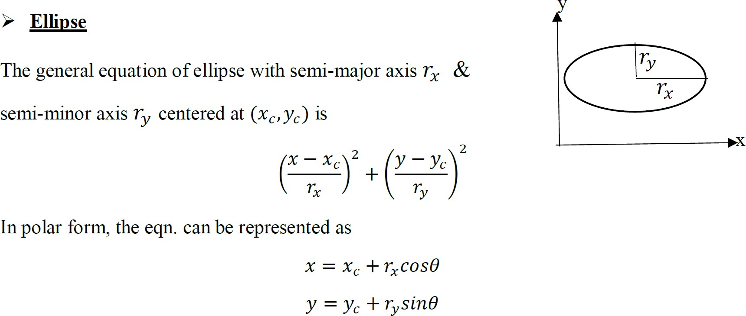

Slide 72
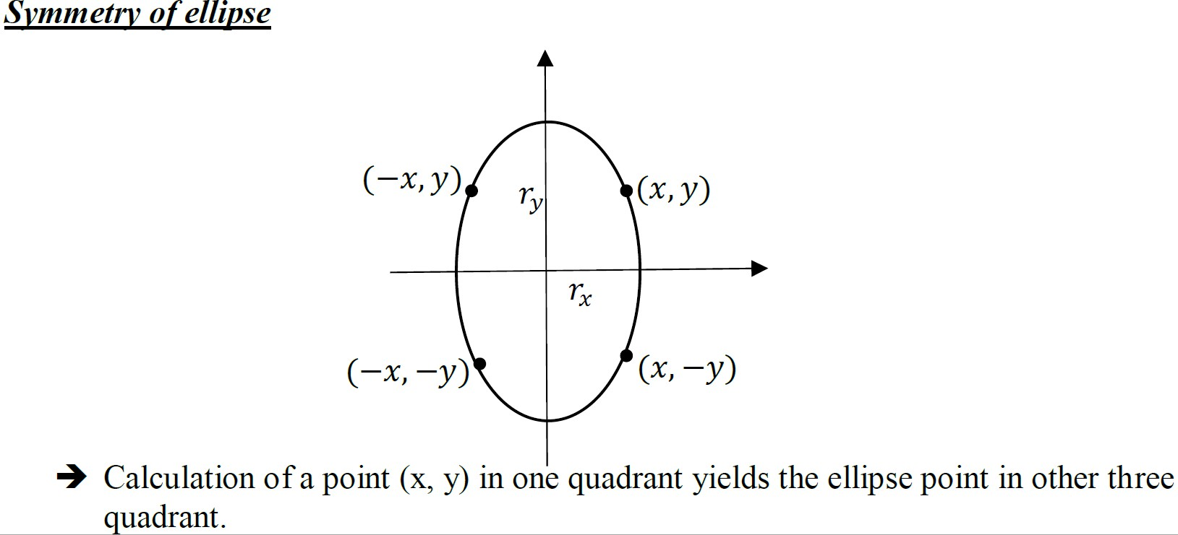

Slide 73
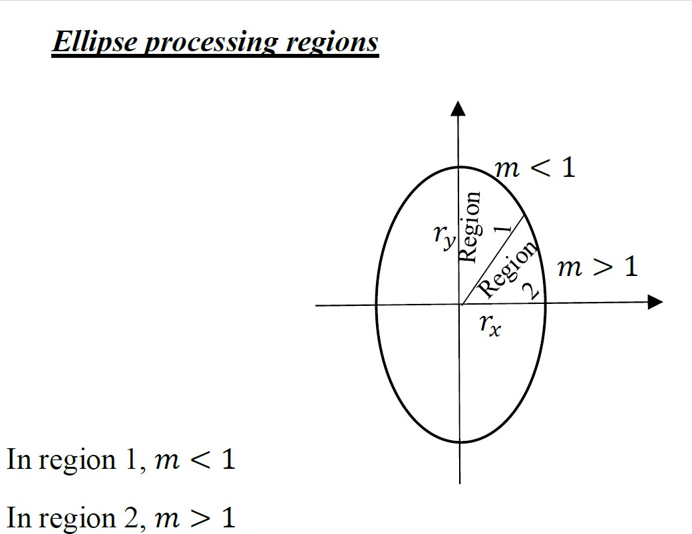

Slide 74
What is an ellipse?
Ellipse is defined as the geometric figure which is the set of all points on a plane whose distance from two fixed points known as the foci remains a constant.
It consists of two axes: major and minor axes where the major axis is the longest diameter and minor axis is the shortest diameter.
Unlike circle, the ellipse has four-way symmetry property which means that only the quadrants are symmetric while the octants are not.
Here, we will calculate the points for one quadrant while the points for the remaining three can be calculated using the former points.

Slide 75
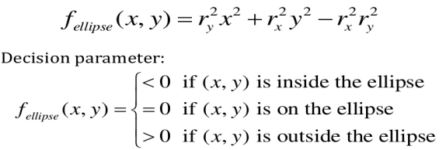
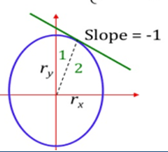
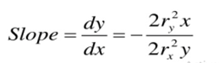
Mid Point Ellipse Algorithm:
We define the equation of an ellipse as
(x²/r_{x}²)+(y²/r_{y}²)=1 where r_{x} and r_{y} are major and minor axis respectively with center origin. We define the ellipse function as

Slide 76
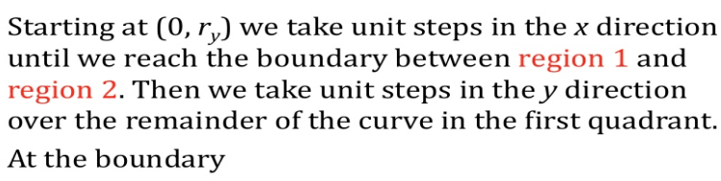
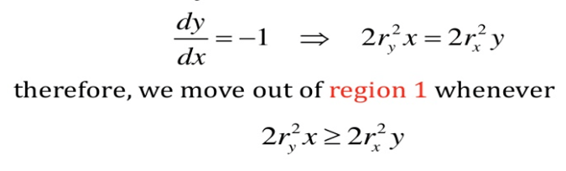

Slide 77
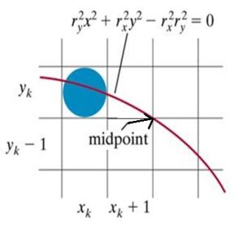
Region 1
Suppose we have just plotted (x_{k},y_{k}). Now the next pixel to be plotted will be either (x_{k}+1,y_{k}) or (x_{k}+1,y_{k}-1).We decide on the basis of mid point of these which is (x_{k}+1,y_{k}-1/2).
So we will put this point in ellipse function f_{ellipse} and check if it is less than zero that means this midpoint is inside the ellipse so that next pixel is (x_{k}+1,y_{k})
or greater than zero then this midpoint is outside the ellipse and if this midpoint is outside so that the next pixel is (x_{k}+1,y_{k} -1).

Slide 78
p_{k} = f_{ellipse}(x_{k} + 1, y_{k} – 1/2)
p_{k} = r_{y}²(x_{k} + 1)² + r_{x}²(y_{k} – 1/2)² – r_{x}²r_{y}²
The successive decision parameter is obtained as
p_{k+ 1} = r_{y}²[(x_{k} + 1) + 1]² + r_{x}²[y_{k+1} – 1/2]² – r_{x}²r_{y}²
Now,
p_{k+1} – p_{k} = r_{y}²[(x_{k} + 1) + 1]² + r_{x}²(y_{k+1} – 1/2)² – r_{x}²r_{y}² – [r_{y}²(x_{k} + 1)² + r_{x}²(y_{k} – 1/2)² – r_{x}²r_{y}²]
= r_{y}²{(x_{k} + 1)² + 2(x_{k} + 1) + 1} + + r_{x}²(y_{k+1} – 1/2)² – r_{x}²r_{y}² – r_{y}²(x_{k} + 1)^{2 –} r_{x}²(y_{k} – 1/2)² + r_{x}²r_{y}²
p_{k+1} – p_{k} = 2r_{y}²(x_{k} + 1) + r_{y}² + r_{x}²(y_{k+1} – 1/2)^{2 –} r_{x}²(y_{k} – 1/2)²
So, p_{k+1} = p_{k} + 2r_{y}²(x_{k} + 1) + r_{y}² + r_{x}² {(y_{k+1} – 1/2)^{2 –} (y_{k} – 1/2)²}
p_{k+1} = p_{k} + 2r_{y}²(x_{k} + 1) + r_{y}² + r_{x}² {(y_{k+1} ² + 1/4 – y_{k+1} ) – (y_{k}²+ 1/4 – y_{k})}
p_{k+1} = p_{k} + 2r_{y}²(x_{k+1} ) + r_{y}² + r_{x}² {(y_{k+1} –1/2)² – (y_{k} -1/2)²}

Slide 79
p_{k+1} = p_{k} + 2r_{y}²(x_{k+1} ) + r_{y}² + r_{x}² {(y_{k+1} –1/2)² – (y_{k} -1/2)²}
Case1
Now if p_{k}< 0 ,then we will select the next pixel (x_{k}+1,y_{k}) , i.e. y_{k+1}= y_{k} so that
p_{k+1} = p_{k} + 2r_{y}²(x_{k} + 1) + r_{y}² + r_{x}² {(y_{k} –1/2)² – (y_{k} -1/2)²}
p_{k+1} = p_{k} + 2r_{y}²(x_{k} + 1) + r_{y}²
p_{k+1} = p_{k} + 2r_{y}²x_{k + 1} + r_{y}²
Case2
Now if p_{k}> 0 ,then we will select the next pixel is (x_{k}+1,y_{k}-1) i.e. y_{k+1}= y_{k} – 1 so that
p_{k+1} = p_{k} + 2r_{y}²(x_{k} + 1) + r_{y}² + r_{x}² {(y_{k} –1-1/2)² – ( y_{k} -1/2)² }
p_{k+1} = p_{k} + 2r_{y}²(x_{k} + 1) + r_{y}² + r_{x}² { (y_{k} -1/2)²-2(y_{k}-1/2)+1- ( y_{k} -1/2)² }
p_{k+1} = p_{k} + 2r_{y}²(x_{k} + 1) + r_{y}² + r_{x}² (2- 2y_{k} )
p_{k+1} = p_{k} + 2r_{y}²(x_{k} + 1) + r_{y}² – 2 r_{x}² (y_{k} – 1)
p_{k+1} = p_{k} + 2r_{y}²x_{k + 1} + r_{y}² – 2 r_{x}² y_{k+1`}

Slide 80
Initial Decision Parameter
Now we calculate initial decision parameter p₀ for region 1, we take the start position at (0, r_{y}).
At k=0.
So , x₀=0 and y₀=r_{y}
Then, p_{k} = r_{y}²(x_{k} + 1)² + r_{x}²(y_{k} – 1/2)² – r_{x}²r_{y}²
Also, p₀ = r_{y}²(0+ 1)² + r_{x}²(r_{y} – 1/2)² – r_{x}²r_{y}²
p₀ = r_{y}² + r_{x}²r_{y}² – r_{x}²r_{y +} r_{x}²/4 – r_{x}²r_{y}²
p₀ = r_{y}² – r_{x}²r_{y +} (1/4)r_{x}²

Slide 81
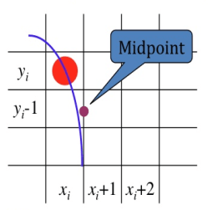
Region 2:
Over Region 2 ,we sample at unit steps in the negative ‘y’ direction and mid point is taken between horizontal pixels at each step.
Probable pixels are (x_{k},y_{k}-1) and (x_{k}+1,y_{k}-1)
Similarly we find the values of decision parameters for region 2 as
p_{k} = f_{ellipse}(x_{k} + 1/2, y_{k} – 1)
p_{k} = r_{y}²(x_{k} + 1/2)² + r_{x}²(y_{k} – 1)² – r_{x}²r_{y}
Successive decision parameter is obtained as
p_{k+ 1} = r_{y}²(x_{k+1} + ½)² + r_{x}²(y_{k+1} – 1)² – r_{x}²r_{y}²
So, p_{k+1} – p_{k} = r_{y}². (x_{k+1} + ½)² + r_{x}². (y_{k+1} – 1)² – r_{x}²r_{y}² – [ r_{y}². (x_{k} + 1/2)² + r_{x}². (y_{k} – 1)² – r_{x}²r_{y}²]
p_{k+1} – p_{k} = r_{y}². (x_{k+1} + ½)² + r_{x}². (y_{k+1} – 1)² – r_{x}^{2.} r_{y}² – r_{y}². (x_{k} + 1/2)² – r_{x}². (y_{k} – 1)² + r_{x}². r_{y}²
p_{k+1} = p_{k} + r_{y}². {(x_{k+1} + ½)² – (x_{k} + 1/2)²} + r_{x}². {(y_{k+1} – 1)² – (y_{k} – 1)² } .

Slide 82
p_{k+1} = p_{k} + r_{y}². {(x_{k+1} + ½)² – (x_{k} + 1/2)²} + r_{x}². {(y_{k+1} – 1)² – (y_{k} – 1)² }
Case 1
If p_{k}> 0 ,then we select x_{k+1}= x_{k} and y_{k+1}= y_{k} -1 so that
p_{k+1} = p_{k} + r_{y}². {(x_{k} + ½)² – (x_{k} + 1/2)²} + r_{x}². [{(y_{k} – 1) – 1}² -(y_{k} – 1)² ]
p_{k+1} = p_{k} + r_{x}². [(y_{k} – 1)² + 1 – 2(y_{k} – 1) – (y_{k} – 1)² ]
p_{k+1} = p_{k} + r_{x}² – 2 r_{x}² (y_{k} – 1)
p_{k+1} = p_{k} – 2 r_{x}² y_{k+1} + r_{x}²
Case 2
If p_{k}< 0 , then we will select x_{k+1}= x_{k}+1 and y_{k+1}= y_{k} – 1
p_{k+1} = p_{k} + r_{y}². {(x_{k}+1)+ ½)² – (x_{k} + 1/2)²} + r_{x}^{2.} [{(y_{k} – 1) – 1}² -(y_{k} – 1)² ]
p_{k+1} = p_{k} + r_{y}². {(x_{k}+1)² + ¼ + (x_{k}+1) – (x_{k} + 1/2)²} + r_{x}^{2.} [(y_{k} – 1)² + 1 – 2(y_{k} – 1) – (y_{k} – 1)² ]
p_{k+1} = p_{k} + r_{y}². [x_{k}² + 1 + 2x_{k} + ¼ + x_{k} + 1 – x_{k}² – ¼ – x_{k}. ] + r_{x}² – 2 r_{x}² . (y_{k} – 1)
p_{k+1} = p_{k} + 2r_{y}^{2 .} (x_{k} + 1 ) + r_{x}² – 2 r_{x}² . (y_{k} – 1)
p_{k+1} = p_{k} + 2r_{y}²x_{k + 1} + r_{x}² – 2 r_{x}² y_{k+1}

Slide 83
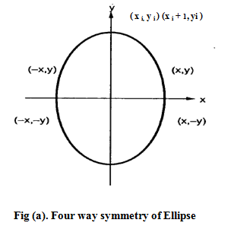
Calculating initial decision parameter
Now we will calculate initial decision parameter p₀ for region 2. Take the start position as the last point calculated in region 1. Put in the following equation and you will get initial decision parameter.
p_{k} = r_{y}²(x_{k} + 1)² + r_{x}²(y_{k} – 1/2)² – r_{x}²r_{y}²
At k=0,
(x_{k},y_{k})=(x₀,y₀)
p₀ = f_{ellipse}(x₀ + 1/2, y₀ – 1)
p₀ = r_{y}²(x₀ + 1/2)² + r_{x}²(y₀ – 1)² – r_{x}²r_{y}²

Slide 84
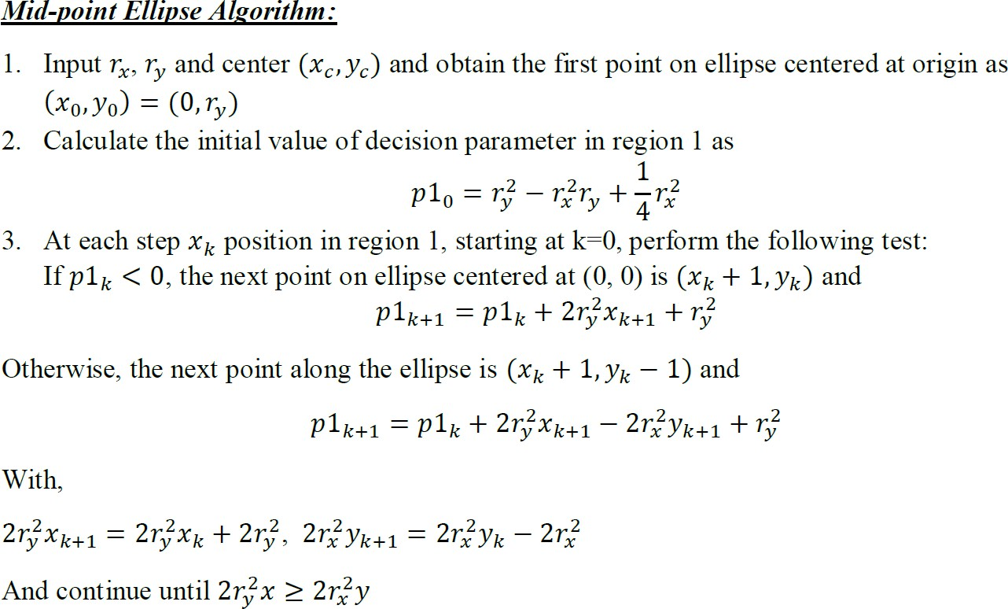

Slide 85
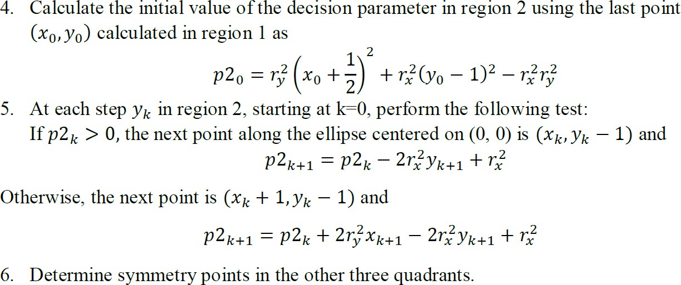

Slide 86
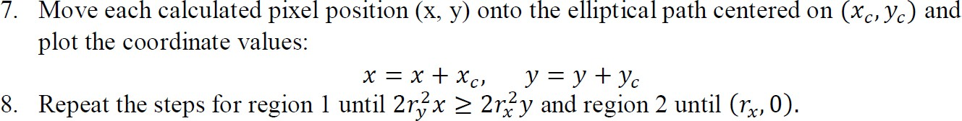

Slide 87
Mid Point Ellipse Algorithm
Input r_{x}, r_{y}, and ellipse center (x_{c}, y_{c},), and obtain the first point as (x,y)=(0,r_{y})
Region 1
2. Then, Calculate the initial value of the decision parameter in region 1 as
p1 = r_{y}² – r_{x}²r_{y +} r_{x}²/4
3. while 2r_{y}²x <= 2r_{x}² y
If p1 < 0
x=x+1 //next point is (x_{k}+1, y_{k})
p1 = p1+ 2r_{y}²x + r_{y}²
else
x=x+1
y=y-1 // next point is (x_{k} + 1, y_{k} – 1)
p1= p1+ 2r_{y}²x + r_{y}² – 2 r_{x}² y
Plot (x_{c}+x,y_{c}+y) (x_{c}-x, y_{c}-y)
(x_{c}-x, y_{c}+y) (x_{c}+x, y_{c}-y)
end while

Slide 88
Region 2
4.Calculate initial decision parameter in region 2 as
p2 = r_{y}²(x+ 1/2)² + r_{x}²(y – 1)² – r_{x}²r_{y}²
5.While y>=0
If p2> 0,
y=y-1
p2=p2- 2 r_{x}² y+ r_{x}² //next point is (x_{k}, y_{k} – 1)
else
x=x+1
y=y-1 //next point is (x_{k} + 1, y_{k} – 1)
p2₌ p2+ 2r_{y}²x + r_{x}² – 2 r_{x}² y
end if
Plot other four symmetrical points.
5.End

Slide 89
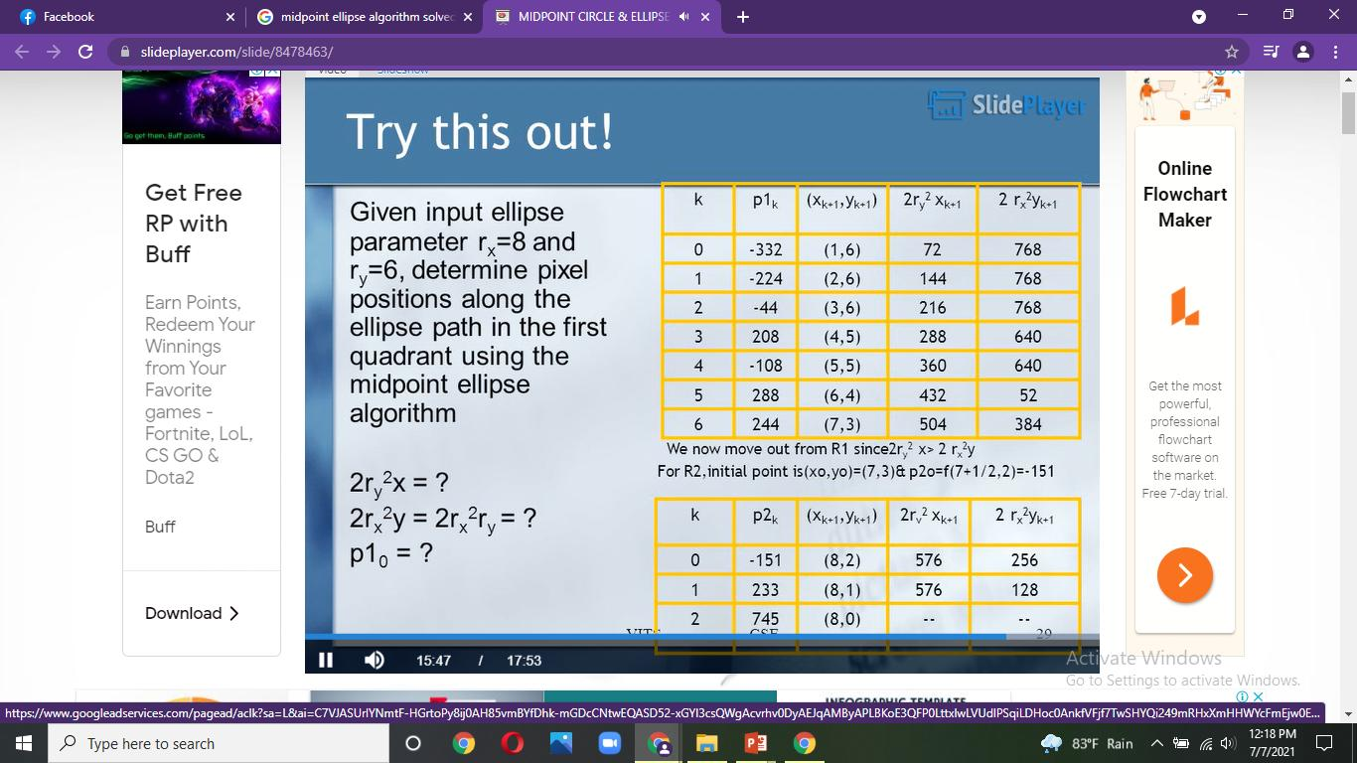
Initial Position (0,ry)
Initial decision parameter for region 1 is
p1 = r_{y}² – r_{x}²r_{y +} r_{x}²/4
If p1 < 0
x=x+1
p1 = p1+ 2r_{y}²x + r_{y}²
else
x=x+1
y=y-1
p1= p1+ 2r_{y}²x + r_{y}² – 2 r_{x}² y
The process is continued while 2r_{y}²x <= 2r_{x}² y
initial decision parameter in region 2 as:
p2 = r_{y}²(x+ 1/2)² + r_{x}²(y – 1)² – r_{x}²r_{y}²
while y>=0
If p2> 0,
y=y-1 and p2=p2- 2 r_{x}² y+ r_{x}²
else
x=x+1 ,y=y-1
p2₌ p2+ 2r_{y}²x + r_{x}² – 2 r_{x}² y

Slide 90
Example
Here,
rx=8,ry=6
Region 1
Start the pixel position at (0,ry)=(0,6)
Initial decision parameter is
p1 = r_{y}² – r_{x}²r_{y +} r_{x}²/4=-332
If p1 < 0
x=x+1 //next point is (x_{k}+1, y_{k})
p1 = p1+ 2r_{y}²x + r_{y}²
else
x=x+1
y=y-1 // next point is (x_{k} + 1, y_{k} – 1)
p1= p1+ 2r_{y}²x + r_{y}² – 2 r_{x}² y
The process is continued while 2r_{y}²x <= 2r_{x}² y

Slide 91
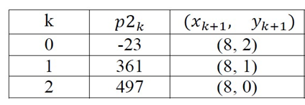
Region 2:
x=7, y=3
Calculate initial decision parameter in region 2 as:
p2 = r_{y}²(x+ 1/2)² + r_{x}²(y – 1)² – r_{x}²r_{y}²
while y>=0
If p2> 0,
y=y-1
p2=p2- 2 r_{x}² y+ r_{x}² //next point is (x_{k}, y_{k} – 1)
else
x=x+1
y=y-1 //next point is (x_{k} + 1, y_{k} – 1)
p2₌ p2+ 2r_{y}²x + r_{x}² – 2 r_{x}² y
Try Example:
rx=7
ry=5

Slide 92
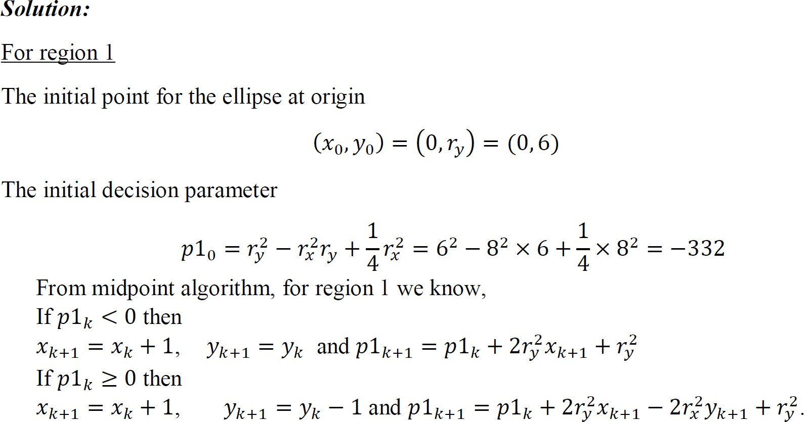
Q. Digitize the ellipse with 𝒓_{𝒙} = 𝟖, 𝒓_{𝒚} = 𝟔 and center at (3, 5).

Slide 93
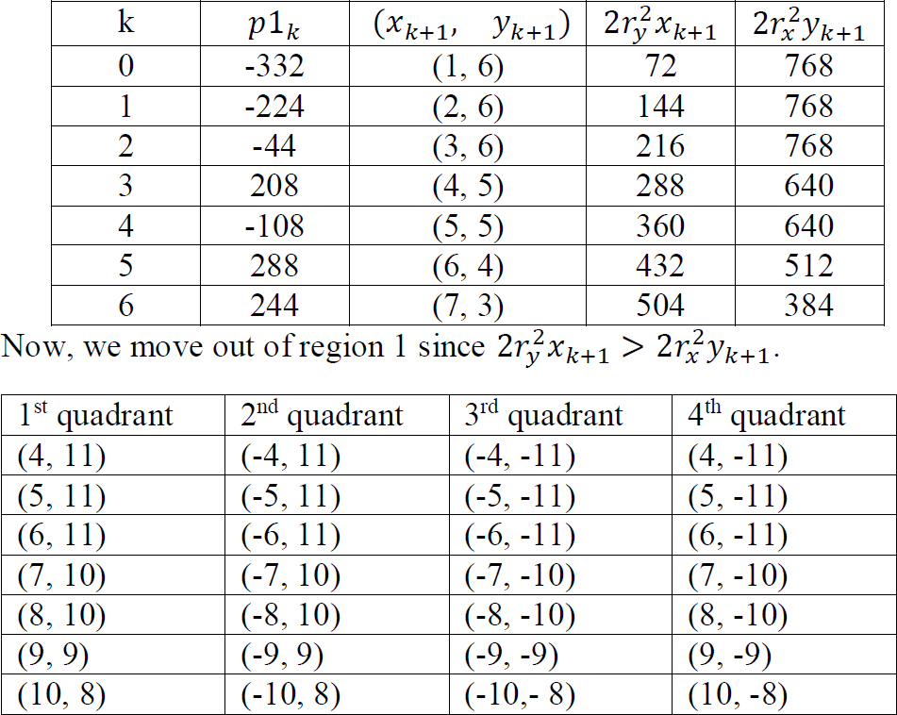

Slide 94
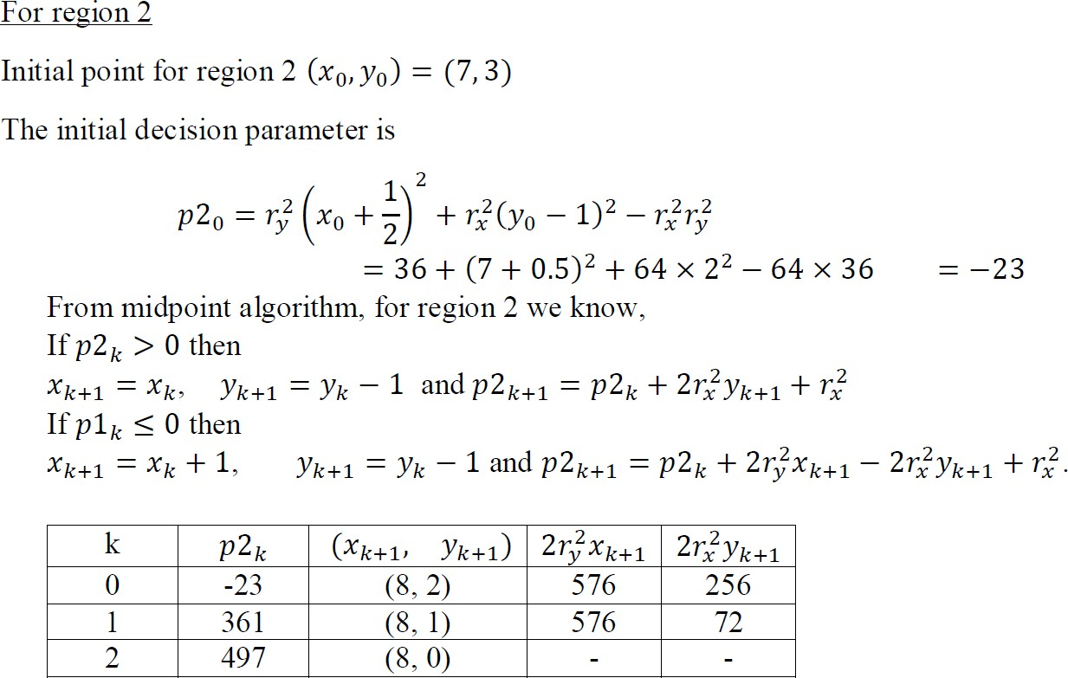

Slide 95
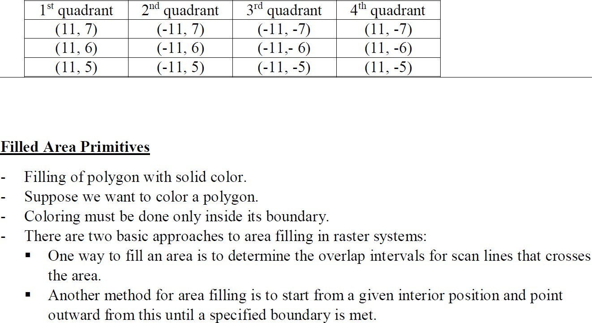

Slide 96
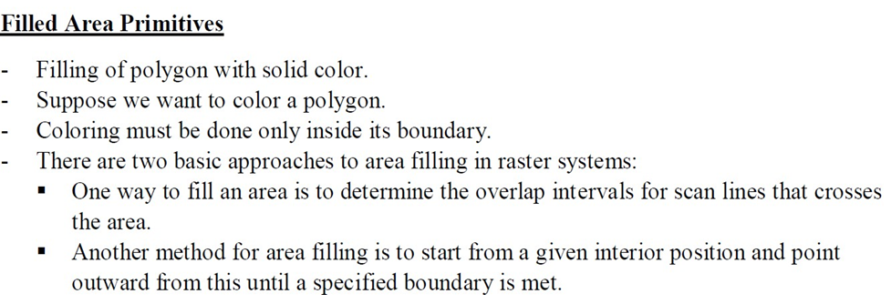

Slide 97
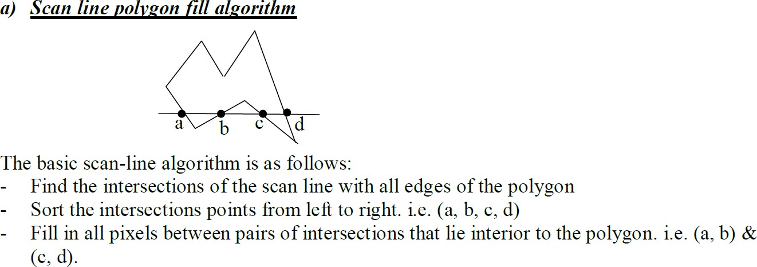
Algorithms for filled area primitives
Scan line polygon fill algorithm
Boundary fill algorithm
Flood fill algorithm

Slide 98
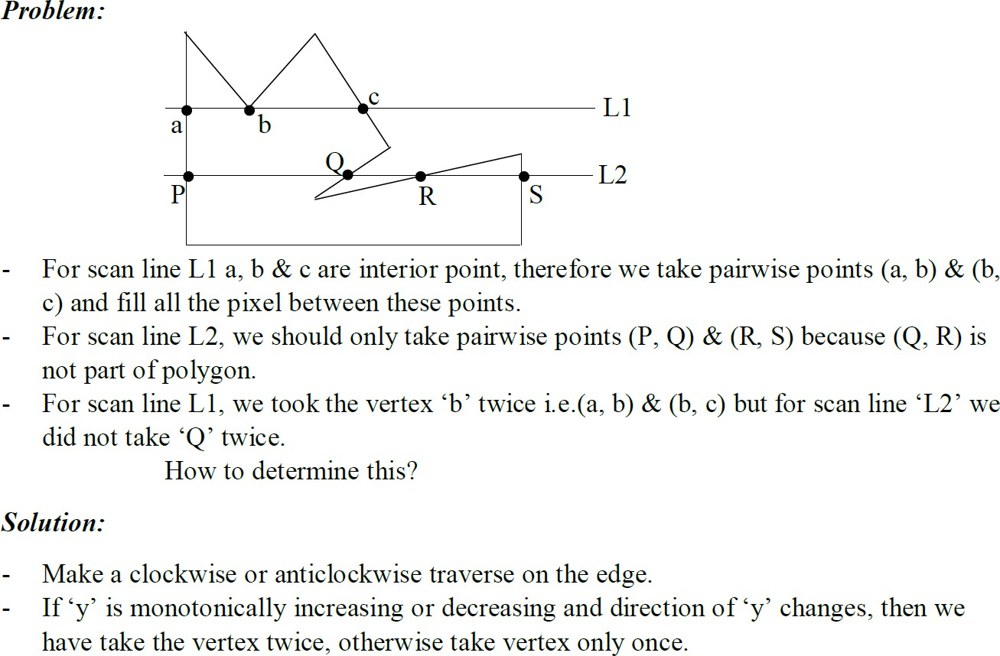

Slide 99
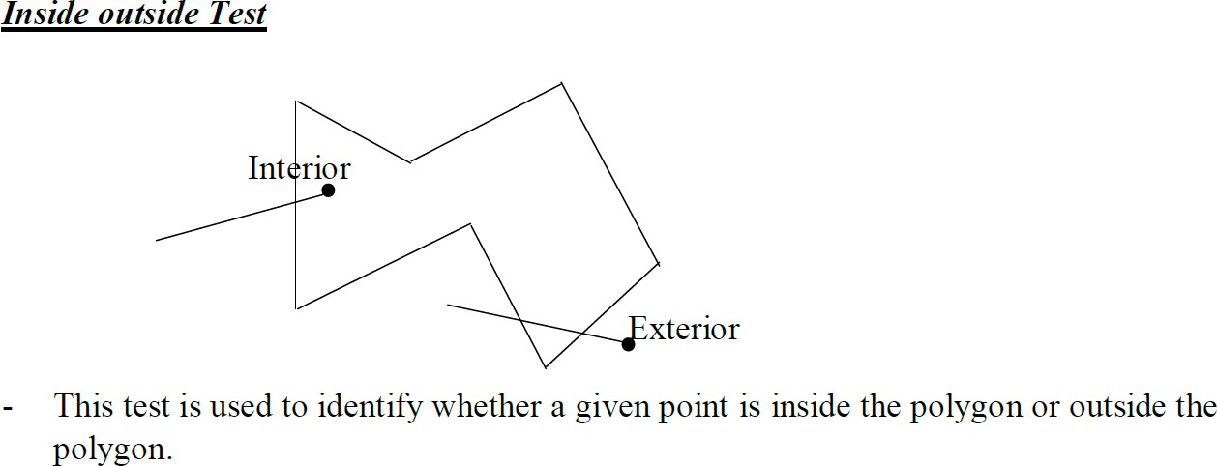
Rule: To identify a point whether it is exterior or interior, draw a line from that point to outside a polygon, if this line crosses even number of edges the point is exterior otherwise it is interior.

Slide 100
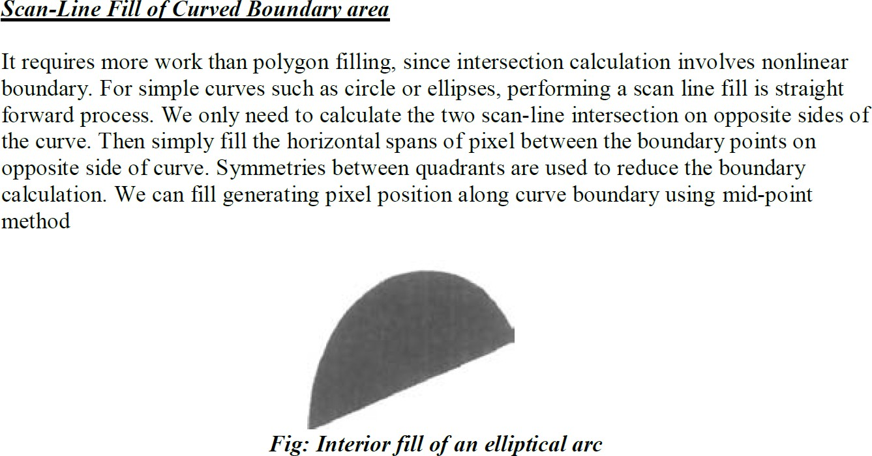

Slide 101
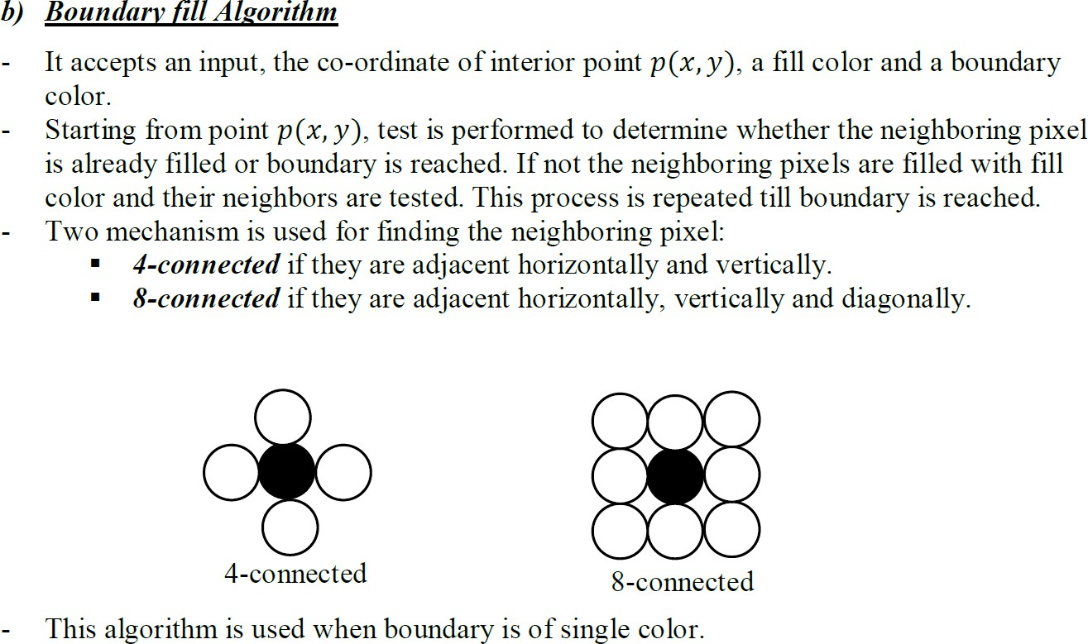

Slide 102


Slide 103


Slide 104


Slide 105
Thank You

